Slide 1

Cultural Webinar Series:
Working with Latin@ Communities
Rosie Hidalgo
Senior Director of Public Policy
Rhidalgo@casadeesperanza.org
Paula Gomez Stordy
Senior Director of Training and TA
pgomezstordy@casadeesperanza.org

Slide 2

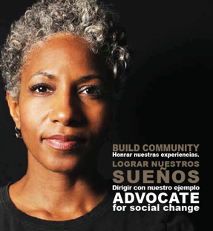
Casa de Esperanza
Starting from a small group of Latina activists in St. Paul, Minnesota in 1982, Casa de Esperanza has grown into one of the largest Latin@ domestic violence organizations in the country.
We recognize that it is the community that will end domestic violence, not any system or organization.
We emphasize developing
social capital (i.e. trust,
reciprocity, information
and cooperation) because we believe it decreases domestic
violence.
Casa de Esperanza © 2019

Slide 3
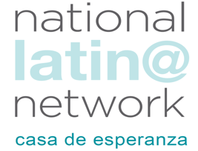
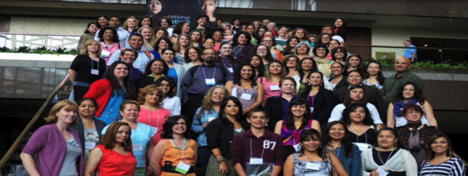
The National Latin@ Network for Healthy
Families and Communities
The National Latin@ Network is a project of Casa de Esperanza and is a national resource center focused on ending domestic violence and sexual assault while promoting the health and well-being of Latin@ communities around the country.
The main goals of the National Latin@
Network are:
  Education and awareness
  Policy Advocacy
  Capacity building and Training
  Research
Casa de Esperanza © 2019

Slide 4
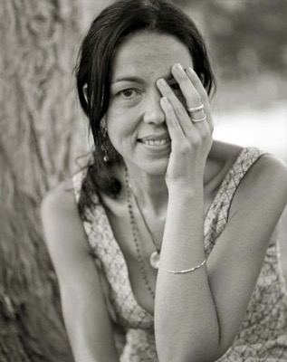
Creating a Comprehensive Framework
Fundamental guidelines:
  DV violates the human rights of survivors & their children by creating unsafe & fearful environments
  Their safety must be central to any work we do
  Safety is unattainable unless we practice cultural and linguistic competency consistently at the organizational and individual level
Casa de Esperanza © 2018

Slide 5

Latin@s in the United States
Approximately 60 million Latin@s living in the U.S. (17% population) (2018 U.S. Census update)
Heterogeneous group
34.2% of Latin@s in U.S. are foreign born (2016 American Community Survey); 65.8% were born in the U.S.
Many families have mixed immigration status: 75% of children in immigrant families are U.S. citizens
Casa de Esperanza © 2019

Slide 6
Our Community is Heterogenous with Lots of Diversity
Race
Ethnicity/Country of origin
Religion
Sexual orientation
Gender identity/gender expression
Immigration status
Immigration experience
First, second, third generation
Size of family
Language
Stages of acculturation
U.S. geographical culture
Economic status
Education
Political affiliations

Slide 7
Galaxy of an Individual
Culture
Class
Gender
Immigration Laws
History
State Laws
Local Community
Faith Community
Children
In-laws
Ethnicity
Spirituality
Work
Police
Family of Origin
Partner
NAFTA
VAWA
Schools
Courts
Philosophy
Service Agencies
Race
Federal Laws
Sexual Orientation
Human Rights
Tapestri, Inc., 2002

Slide 8
What are the barriers a survivor faces?
In what category would you place them?
What is the impact of intersectional barriers?
Abuser-
generated
risks
Life-generated risks
System-
generated risks

Slide 9
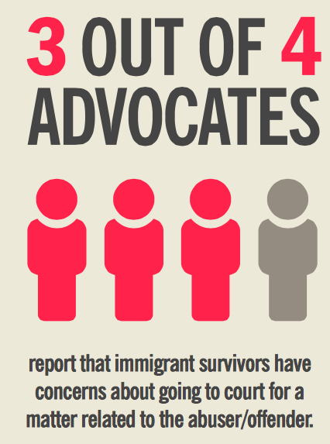
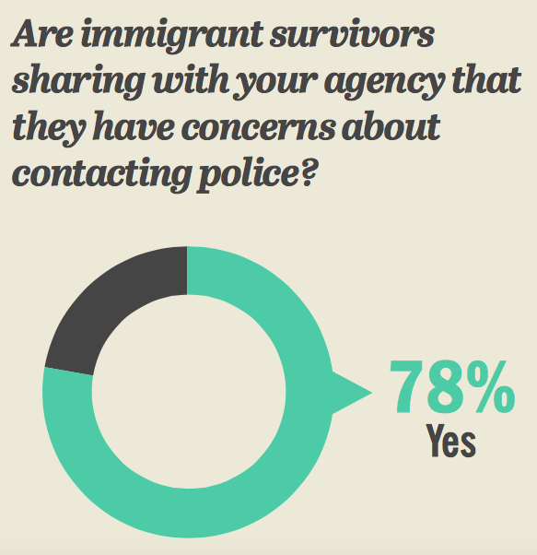
Addressing Concerns: Going to Court or Contacting Police
Survey conducted by: NNEDV, NAESV, Tahirih Justice Center, ASISTA, National DV Hotline, API-GBV, Casa de Esperanza

Slide 10
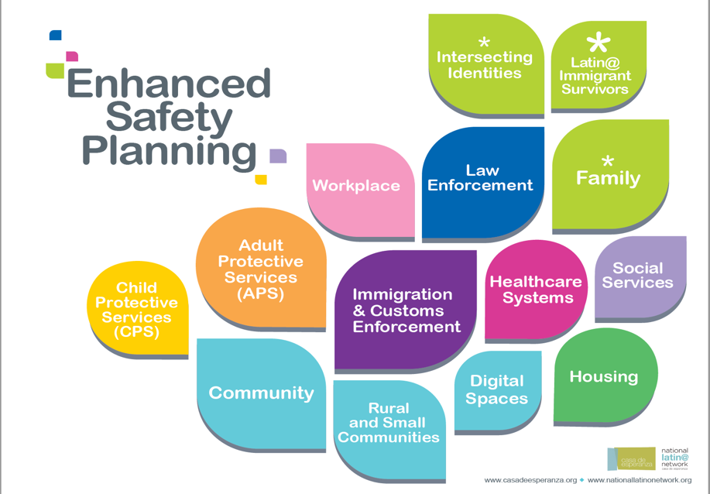
Casa de Esperanza © 2019

Slide 11
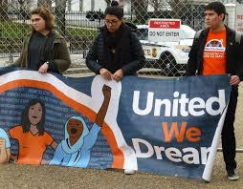

Importance of Strengths-Based Advocacy
Acknowledging the survivor’s courage and strength
Asking the survivor what her/his goals and priorities are
Understanding and building community resources and networks
Strengthening Community Engagement

Slide 12
Cultural Orientations
Group Oriented Culture
Storytelling/narrative
Individualistic Culture
Bottom line/Bullet list
By Dr. Nicolas Caballeira

Slide 13
Essential Cultural Orientations
I------------------------<SELF>---------------------------We
doing----------------<WORTH>---------------------being
boundaries-------<RELATIONSHIPS>----------Intimacy

Slide 14
Culturally Relevant Communication
Observe
Actions, words, thoughts expressed
Reflect
What this means
Act
Match the communication style

Slide 15
Cultural Competence
Cultural Responsiveness
Cultural Humility
Casa de Esperanza © 2018

Slide 16

Cultural Competence
Implementation of congruent behaviors
Policies that come together in a system or agency and professionals
Enables professionals to work effectively cross-culturally
Domestic violence: Intersectionality and Culturally Competent Practice edited by Lettie L. Lockhart and Fran Danis

Slide 17
Cultural Responsiveness
Respect for difference
Eagerness to learn
Willingness to accept many ways of viewing the world
Casa de Esperanza © 2018

Slide 18
Cultural Humility
Recognize/reject our pre-existing beliefs
Resists classifying or labeling
Understanding information provided by individuals
Casa de Esperanza © 2018

Slide 19
Absence of both
Trauma-informed awareness &
cultural awareness will impact judgment

Slide 20
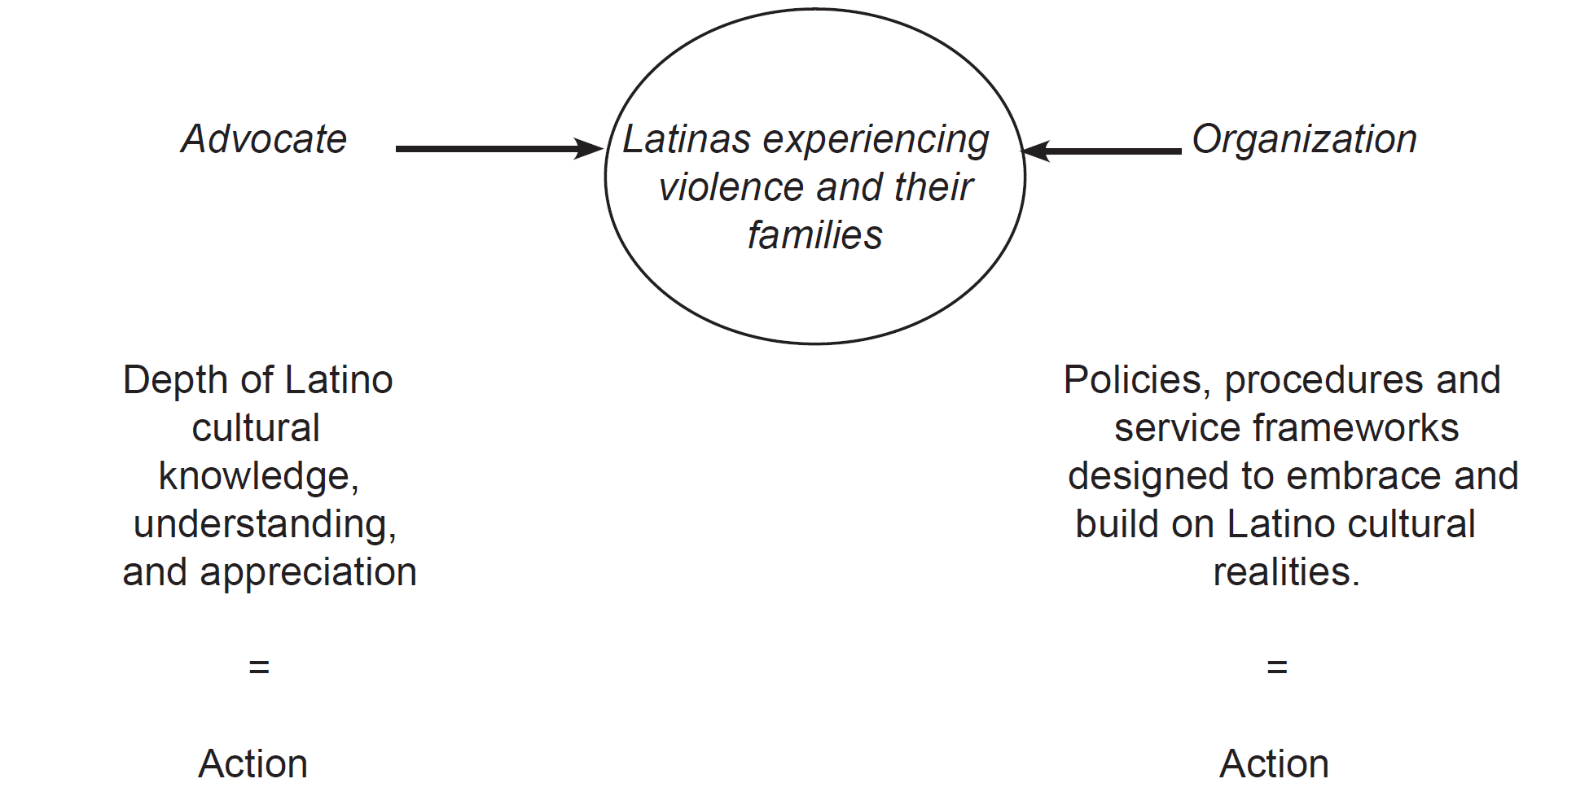
Organizational commitment
Casa de Esperanza © 2019

Slide 21
Outreach or Engagement?
What kind of relationship do you have with community members?
How do your organizational policies and structures support community engagement?
How are you getting people involved? When?

Slide 22
Outreach vs. Community Engagement
Outreach | Community Engagement
Relationships are for the purpose of completing a project | Is continually built between and among people and groups. Continuous
Relationship can be limited to a few community members | Relationship are built not just with current leaders, but also with people with an interest and potential
Relationships are short term, so staff have to rebuild them as other projects or issues come up | Relationships are transformational and long-term, community can engage in projects as they come up
Activities include distributing flyers, surveys, focus groups, workshops | Activities include listening sessions, one-on-one meetings, celebrations, leadership development, community building projects
Staff/institutions generate ideas they think the community will support | Staff/institutions support community members in generation their own ideas
Staff/institutions generate solutions to a problem they have defined | Staff/institutions engage in continual self-reflection to incorporate people’s ideas, feedback, talent

Slide 23
Fuerza Unida
Listens to the stories and hopes of Latin@s to inform the development of strategies that engage the community in ending domestic violence and addressing other community identified priorities.
Develops skills in leadership necessary to support, educate and encourage Latin@ communities to live healthy lives free of violence.
Prepares community members as first responders and as “bridges” to the community – community leads the change.
Casa de Esperanza © 2014

Slide 24
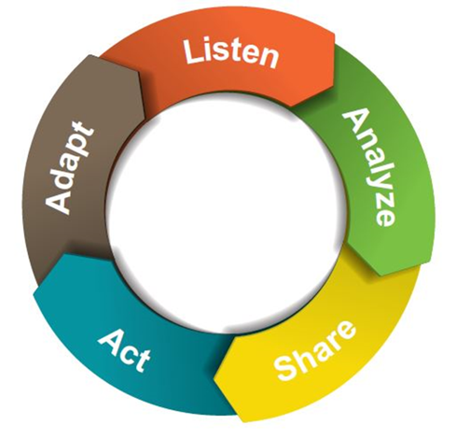
Listening Process/CE Framework

Slide 25

“When you start with problems, you create programs, when you start with strengths, you create opportunities.”
Lupe Serrano

Slide 26
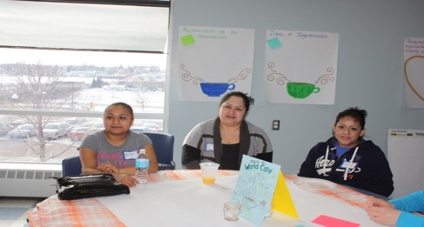
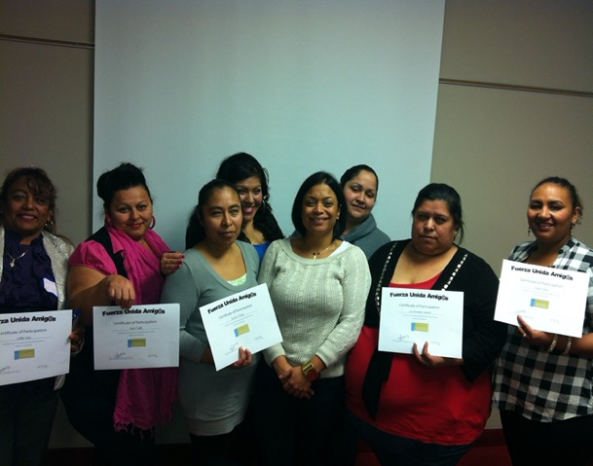
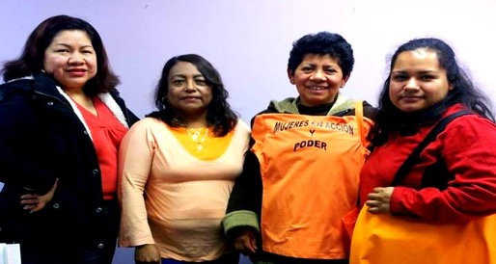
Fuerza Unida Amig@s
Casa de Esperanza © 2014

Slide 27
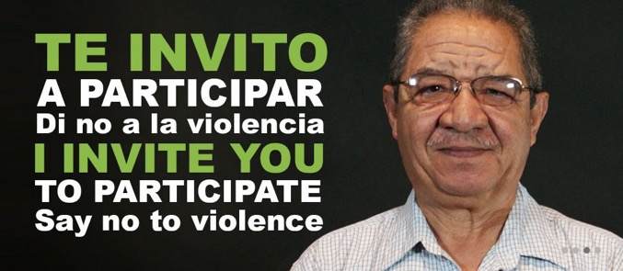
Key Message: Invite Men to Participate
Te Envito Campaign
Engaging Latino Men in DV Prevention Toolkit

Slide 28

DECIMOS NO MÁS
Preparing the Next Generation
Nearly two-thirds of Latin@s (60%) are willing to get involved in efforts to address domestic violence and sexual assault.
More than 4 in 5 Latin@s (83%) are willing to talk to their children and the children in their lives about healthy relationships.

Slide 29
Community Engagement and Collaboration
That means that when we engage community in these conversations, we need to be prepared to
1. listen to community
2. take action on what community is telling us.
Our work becomes about being responsive to community identified needs, where we work to put the tools, resources and supports in the hands of community so that they take leadership in getting involved.

Slide 30

Coordinated Community Response – not just Systems Response
Casa de Esperanza © 2019

Slide 31
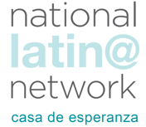
Improving Access to Safety and Well-Being – Broadening the Lens
  Supporting culturally specific community-based organizations
  Alternative pathways to safety
  Community Engagement – not just Community Outreach
  Alternative Justice Responses
  Programs for those who cause harm
  Prevention programming
  Youth-led Initiatives
  Workplace Safety and Economic Justice
Casa de Esperanza © 2019

Slide 32
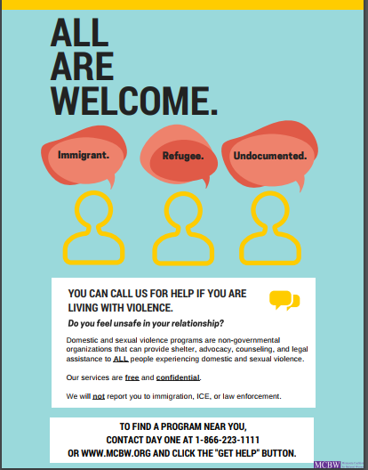
Addresses –
Immigrant
Refugee
Undocumented
Includes -
We will not report you to
Immigration, ICE, or law enforcement
For more information, contact
www.MCBW.org
Developed by Violence Free MN:
https://www.vfmn.org/immigration-resources

Slide 33
Just because a program does not turn someone away, does that constitute “Meaningful Access?”
In order for access to services to be “meaningful access,” it is necessary to ensure language access for individuals with Limited English Proficiency (LEP).
Casa de Esperanza © 2019

Slide 34
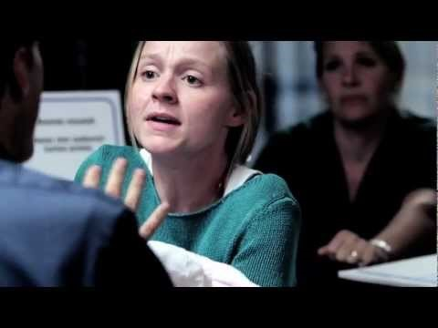

Slide 35
Thoughts/impressions?

Slide 36
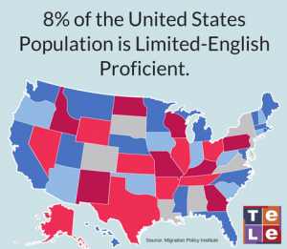

Who are individuals with LEP?
https://telelanguage.com/limited-english-proficiency-lep-populations-by-u-s-state/
Casa de Esperanza © 2019

Slide 37

Languages Spoken in the u.s.
1 out of 5 people living in the US can speak a language other than English in the home.
Seven languages (Spanish, Chinese, Tagalog, Vietnamese, French, Korean, and German) each have over 1 million speakers in the US.
This Photo by Unknown Author is licensed under CC BY-NC-ND
Kushinka, M. (2017, August 23). How Many Languages Are Spoken in the US? [Infographic]. Retrieved July 13, 2018, from https://www.redlinels.com/how-many-languages-are-spoken-in-the-us/

Slide 38



Why provide Meaningful Language Access?
1. It’s the right thing to do
  2. It improves access to services and enhances outcomes & access to safety
  3. It’s a Legal Obligation
  (under Title VI of the Civil Rights Act)

Slide 39

Requirements for Recipients of Federal Funds and Federal Agencies
If an organization receives any federal funds, then all aspects of that organization are obligated to take reasonable steps to ensure that individuals with LEP have meaningful access to the benefits and services provided by that organization.

Slide 40

It Enhances Access to Safety and Well-Being
  By being proactive and implementing a language access plan, we ensure that all individuals with limited English proficiency (LEP) have
  meaningful access to critical services.

Slide 41
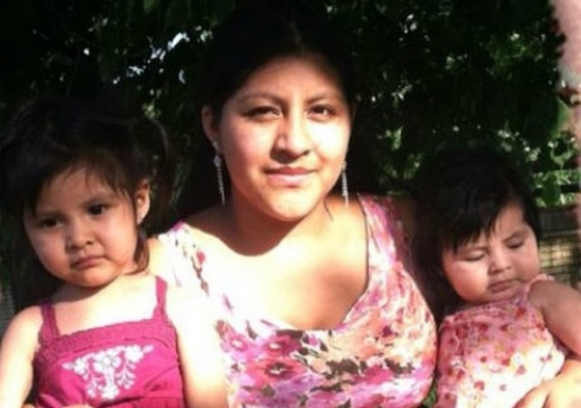
Why Provide Meaningful Access?
Daisy and daughters Daniela, 2, and Yoselin, 1.

Slide 42

Language Access Tools nationallatinonetwork.org/lep-toolkit-home
Free, bilingual tools to help your organization create language access plans.
Step-by-step materials to help you advocate for immigrant survivors with limited English proficiency.

Slide 43
Journey from Social Services to Social Transformation
Understanding that ending domination/power/control at the route of gender-based violence… means working to end domination/power/control at the root of other forms of oppression & domination in society
Starting with our own relationships, organizations, and role in the community

Slide 44
“Nonviolence is not sterile passivity,
but a powerful moral force which makes for social transformation.”
Martin Luther King

Slide 45




Contact Information- Casa de Esperanza
Rosie Hidalgo
Email:Rhidalgo@casadeesperanza.org
Paula Gomez Stordy
Email: pgomezstordy@casadeesperanza.org
casadeesperanza.org
nationallatinonetwork.org
facebook.com/casadeesperanzamn
@casadeesperanza

