Slide 1
On the Front Lines: COVID-19 and Domestic Violence
Research Updates from the University of Texas Medical Branch
Center for Violence Prevention
Leila Wood, PhD, MSSW

Slide 2
Before COVID-19
We researched occupational stress among 530 members of the Texas DV and SA workforce. We found:
High rates of mission, compassion, and job satisfaction
High rates of burnout, secondary traumatic stress.
High burnout, low salaries, and identifying as black was associated with turnover intention.
Low STS, increased use of coping, workplace community predicted job satisfaction.
The VOICE Study findings can be found at https://sites.utexas.edu/idvsa/research/domestic-violence-interpersonal-violence/victim-services-occupation-information-and-compensation-experiences-survey-2017/

Slide 3
We also found
Staff who used more coping skills had higher job satisfaction.
Microaggressions in the workplace, recent trauma/life events, and younger age predicted burnout and STS.
Being an IPV/SA survivor did not predict burnout or STS.
Articles:
Voth Schrag, R., Wood, L., Wachter, K., & Kulkarni, S. (Online First, 2021). Compassion fatigue among the intimate partner violence and sexual assault workforce: Enhancing organizational practice. Violence Against Women.
Wachter, K., Voth Schrag, R. & Wood, L. (Online First, 2019). Coping behaviors mediate associations between occupational factors and compassion satisfaction among the intimate partner violence and sexual assault workforce. Journal of Family Violence.
Wood, L., Wachter, K., Rhodes, D.M., & Wang, A. (Online first, 2019). Turnover intention and job satisfaction among intimate partner violence and sexual assault professionals. Violence and Victims.

Slide 4
COVID-19 and DV and Sexual Assault
Preliminary evidence indicates that both the rate and severity of IPV, sexual assault, child maltreatment and other forms of interpersonal violence have increased in the wake of “stay-at-home” and social distancing guidelines related to COVID-19 while reporting and service access have declined.
A recent study indicates DV rose at least 8% (Piquero et al., 2021).
The COVID-19 pandemic is occurring alongside what is often referred to as a “second” pandemic of racial injustice in the United States, with BIPOC at heightened risk for both interpersonal violence and COVID-19.
Hotlines across the nation have seen a surge of use from people in unsafe situations who are unable to leave their homes (Jaramillo, 2020) though some research indicates that survivors often feel less safe reaching out for help or calling the police while in close proximity to the abusive partner ( National Domestic Violence Hotline (NDVH), n.d.; SAMHSA, 2020).

Slide 5
A perfect storm for our workforce
Violence prevention and intervention staff not typically given "first responder" designation though providing life saving interventions.
The VOICE study findings indicate the role of:
1). Recent life stress and
2). Microaggressions and oppression, particularly racial injustice in DV/SA workforce experience
UTMB CVP goal was to capture rapid data for analysis and response to help our workforce.

Slide 6
The COVID-19 Safety Survey
The survey was created by UTMB CVP researchers and reviewed by practitioners.
The survey was fielded from April 8th through June 8th, 2020 and took on average 8 minutes to complete.
All survey questions were voluntary and the survey was available in English and Spanish. Participants had the option to sign up for a giftcard raffle in a separate survey (A total of 30 $20 giftcards were distributed).
The survey was advertised for any adult survivor (victim) of domestic violence, child abuse, sexual assault, human trafficking, or any other type of interpersonal violence or those who work in a professional role with survivors of domestic violence, child abuse, sexual assault, and/or human trafficking or any other type of interpersonal violence.
Respondents from 24 states and DC (Majority Texas)

Slide 7
Survey Versions
Safety Concern Pathway | Staff Pathway
Section 1: Demographics (age, race/ethnicity, gender, living situation). | Section 1: Demographics (age, race/ethnicity, gender, living situation).
Section 2: Work and health (e.g., have you been tested for Coronavirus? Did you lose your job or have your hours/reduce) | Section 2: Work and health (e.g., have you been tested for Coronavirus? Did you lose your job or have your hours/reduce)
Section 3: Safety and safety planning strategies (e.g., How has your safety from violence, threats, stalking or abuse changed since the Coronavirus pandemic began?) | Section 3: Client safety and safety planning strategies (Thinking about your clients overall: How has their safety from violence, threats, stalking or abuse changed since the Coronavirus pandemic began?).
Section 4: Virtual and phone services during COVID-19 | Section 4: Work adaptations, technology and work stressors

Slide 8
Pathway One: Active Safety Concerns
53 participants, 82% female-identified
24% needed COVID-19 test and could not get one
18% lost own job, 42% had household member lose job, 62% essential workers
Relationship difficulty in the home unit increased for 80.9% of participants.
40% experienced safety decrease since COVID-19

Slide 9
Survivor Pathway- What would help with safety?

Slide 10
Voices of participants
Resource Loss
“Access to resources all but disappeared, became homeless and quarantine happened two weeks later. This shelter did not provide access to community resources, I got a list of housing etc from an advocate at another shelter. Even so, what places were open did not have any availability”
Safety Concerns
“Right now, my biggest concern is that my children may be being abused by their father. With limited time and money due to the coronavirus, getting organized and financially prepared for legal action is very difficult (something that is still difficult outside this situation as a single mom of young children). I'm concerned that the court system is going to be tied up before extended summer visitations…”
Health and Safety
“ I was quarantined. So my job doesn't let me take it easy at work. They are more demanding than ever….Hard to eat and function. Dr says I am under stress.”

Slide 11
Pathway Two: Violence Prevention and Intervention Staff

Slide 12
Focus on Domestic Violence and Sexual Assault Staff
352 respondents
Nearly 5% of workers had lost their jobs or had a reduction in hours since the pandemic began, and 33.8% of workers had someone in the household lose their job or experience a reduction of hours.
147 respondents had problems accessing food or needed personal supplies.
80% essential workers
Most commonly noted job difference was shift to telehealth. There was a 51% increase in use of video conferencing – no differences by job position. Other major occupational changes included working from home (78 participants) and lack of resources for clients (78 participants)

Slide 13
Worker Needs
Over 84% reported at least some increase in stress since the pandemic began, with 23.9% reporting work was a lot more stressful.
Strategies to reduce stress at work include better communication (31 participants) agencies resources to address staff (31 participants) more resources for clients (30 participants) and mental health support for workers (28)
Needed to improve response to clients during pandemic were financial supports for clients (70) and increase housing resources (56 participants)

Slide 14
Voices from participants
Economics
“My issue is with childcare. I have two daycare aged children and both myself and my husband are essential workers. I have had to reduce my work hours with the blessing of my employer due to not having access to childcare. This has financially effected my family.”
Safety
“Establishing safety with clients while meeting via Zoom is different since before they would come into my office and there were no fears of being interrupted or overheard by the perpetrator”
Resource Loss
“I work at a hotline, so people are already in crisis when they call us, but they're more escalated right now. We've been getting a lot more non-dv/sa/ht related calls from the Spanish speaking and immigrant population who are terrified, broke, and need financial resources, of the ten-15 shelters we used to refer to besides ourselves, there are only two INCLUDING US (emphasis is participant’s) that are open as usual. All others have either closed or are only accepting a certain demographic/locality of people. My job has gone from saying "no, but try this" to "I don't know, but stay connected". It's hard.”

Slide 15
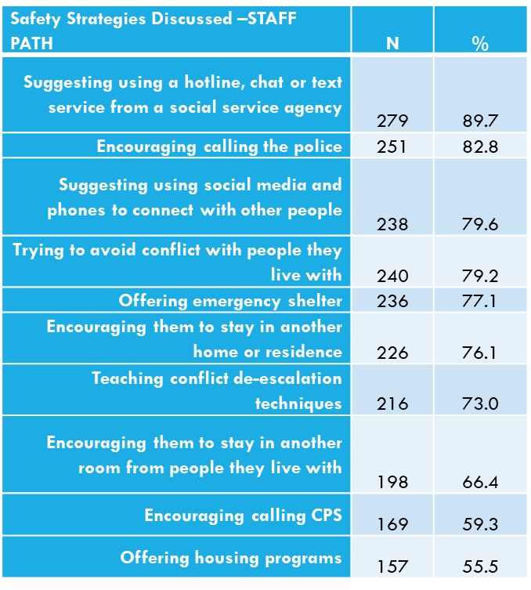
Side by Side: Safety Strategies

Slide 16
More Data, Common Themes
Family safety broadly has decreased: Study of Texas survivors 50+ found 52% had seen increase in relationship difficulty
Case volume may go down, but intensity of need and violence has gone up.
Staff turnover- due to budget, strain, and family issues- is a pressing concern.
Economic and housing concerns intensified: Study of Texas survivors 50+ found 30% lost jobs or had hours reduced. Study of children’s DV related services found childcare loss major issue.
Shifts to virtual services offers opportunities and challenges- without a lot of guidance
Mental health impacts for staff and clients, old and young.

Slide 17
The Supporting Advocates Pilot Program
Partnership with Texas Council on Family Violence (TCFV)
Counseling program
Up to free 6 sessions
Open to all frontline/ first responder DV staff in community-based programs who do not have access to free trauma counseling (different from EAP).
Sessions are provided by phone or video (additional benefit of scaffolding virtual services).
Services available first come, first serve for qualified participants.

Slide 18
Supporting Advocates: Approach
COVID-19 as an acute potential trauma
Partnership with two counseling providers: Prickly Pear and Mines and Associates
Both providers have diverse counseling providers that offer services in English and Spanish.
Criteria for counselors includes:
Trauma expertise
Workplace stress expertise
Telehealth provider
Expertise in brief counseling models
Preferred: Experience with DV and sexual assault

Slide 19
Supporting Advocates: Program to Date
Began with two pilot programs
Invitation sent to larger group over TCFV listservs
Enrolled 55 of 60 potential participants.
Pre-session survey highlights of those enrolled (n=55)
Majority in advocacy/counseling roles
83% say work stress increased
72% say client safety is worse since COVID-19
65% are confident or very confident in ability to provide virtual services
Main goals for counseling are coping skills, get help with life stressors, and discuss work problems.

Slide 20
Supporting Advocates: Next Steps
Complete program for current group
Test pilot program benefits to improve approach
Funding for expansion
Development and addition of peer support groups
Additions of structural changes (pay, paid leave, benefits) and supervision models

Slide 21
Contact Information
Leila Wood, PhD MSSW
Assistant Professor
Center for Violence Prevention Department of Obstetrics and Gynecology
The University of Texas Medical Branch
leiwood@utmb.edu
https://www.utmb.edu/cvp

