Slide 1

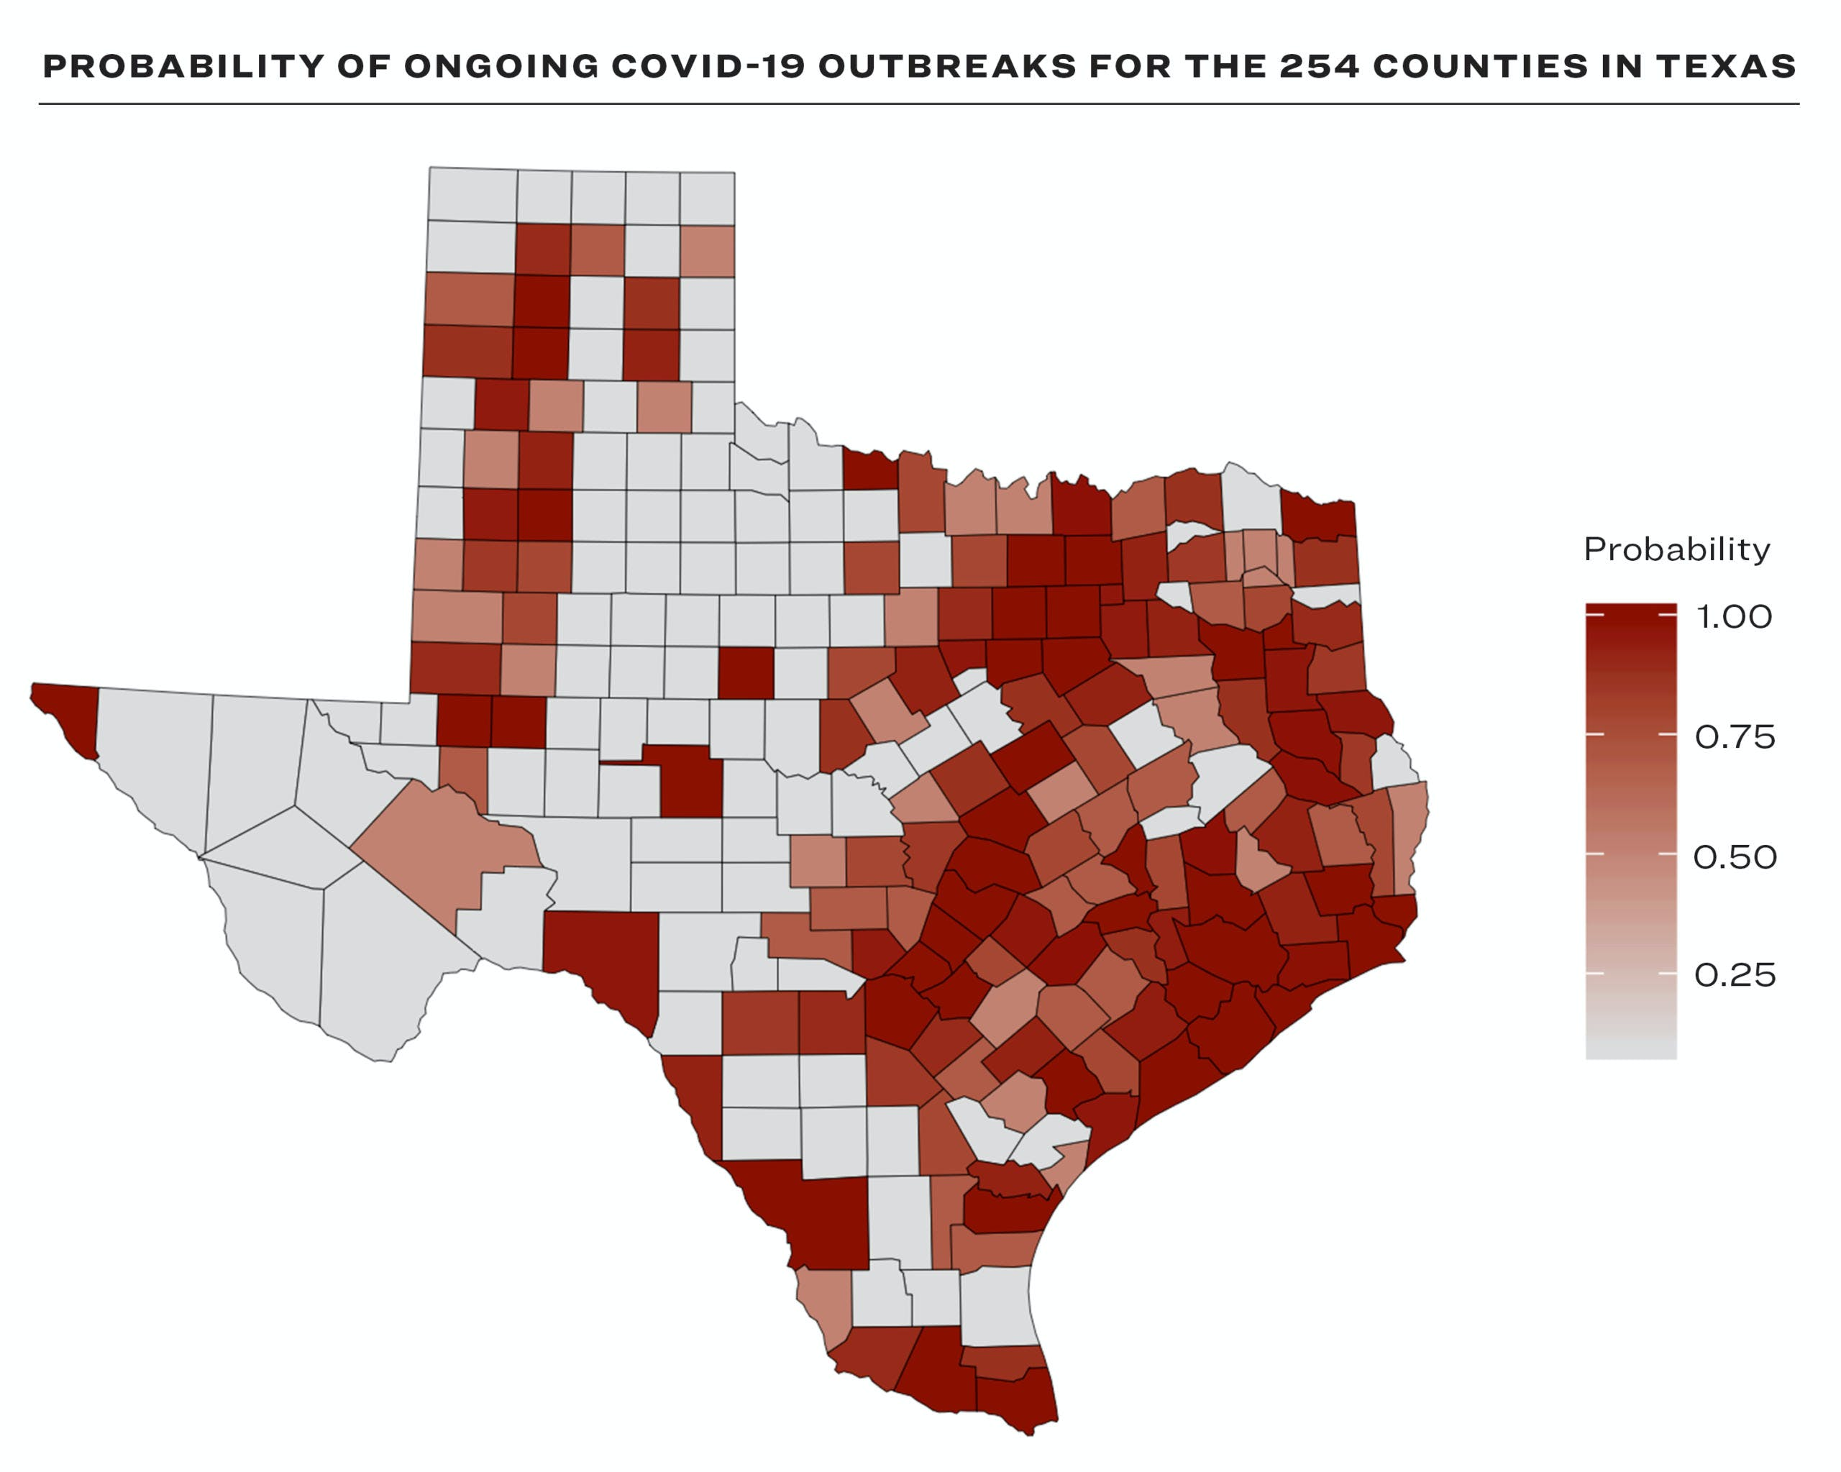

Slide 2
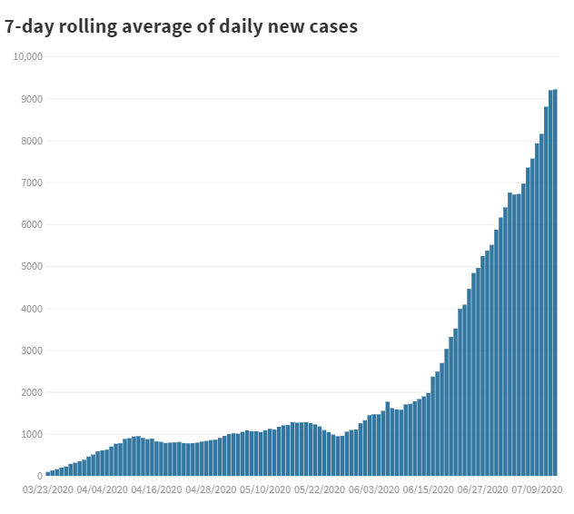
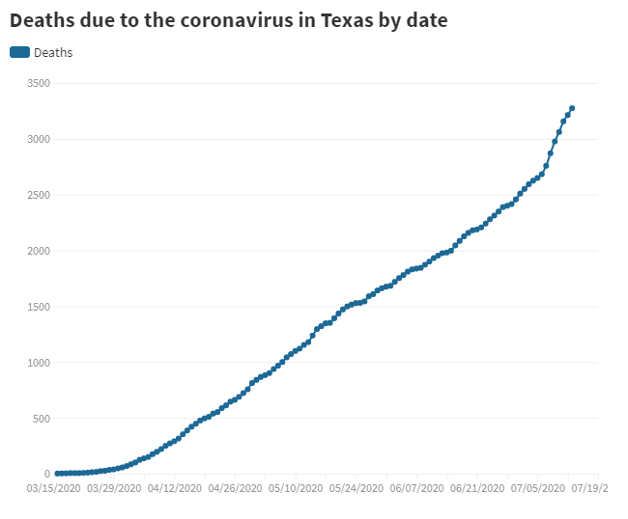
COVID Data as of July 9th

Slide 3
Interactive Map
Texas scan

Slide 4
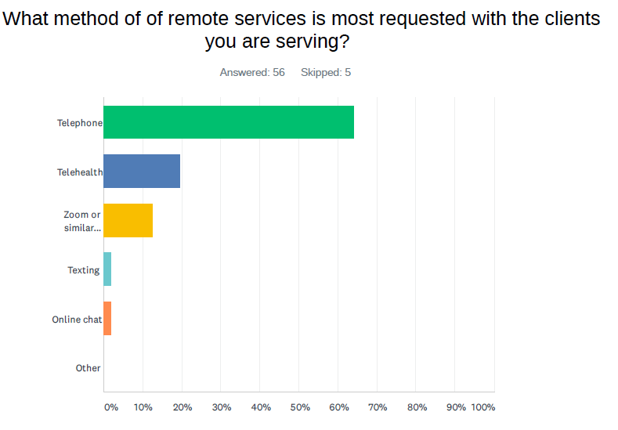
TCFV Survey: 33 Questions / 60 Executive Leaders
What do you wish your organization had in place prior to the pandemic?
19% answered supplies.
48% answered technology.
33% answered procedures/policies.

Slide 5
“Our struggle is staffing the shelter when multiple shelter staff are testing positive. We are requiring the staff that were directly exposed to self quarantine as well. I'm concerned with burnout for those still available for work. Yesterday we sent clients to a hotel, so we can catch a breath and hire additional staff (yes we are also short staffed).” East TX
What EDs are saying….
"I have spent nights and days churning with a mixture of anxiety, overwhelm and sheer panic that I have not considered some approach, went too far or not considered enough feedback. There has not been enough time in the day to address e-mails or reach out b/c the now is filled with new challenges that seemingly always need some immediate attention." DFW Area
“I sometimes feel like I am trying to fight a forest fire with a squirt gun. Thanks for giving us a moment to reflect that we aren’t in this alone, and more importantly, to recognize the toll this pandemic is taking on our staff, our clients, and ourselves is significant. The mental and physical exhaustion are real. We have to be sure our staff takes the time to let some water run back in their emotional well—and then we have to take that advice for ourselves.” Rural TX

Slide 6
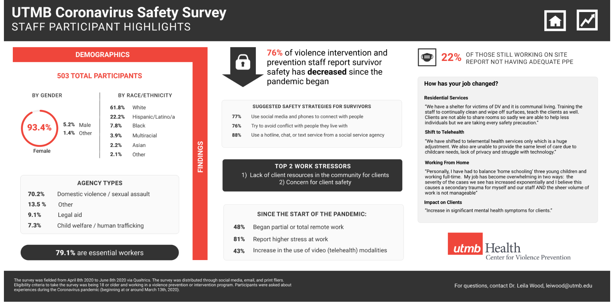

Slide 7

COVID-19 pandemic has created an exponential increased strain on the violence prevention and intervention workforce through increased service demands, lack of technology, safety concerns due to social distancing, and transitioning face-to-face service models to be conducted virtually.
Findings underscore that first responders in the child maltreatment and domestic violence field are in urgent need of support to mitigate the impact of the COVID-19 pandemic, prevent the development of burnout, STS, turnover, and help families get the support they need via telehealth.
Aim 1: Provide Individual Telehealth Counseling Services for Violence Prevention and Intervention Staff.
Aim 2: Train Texas Violence Prevention and Intervention Workers in the Fundamentals of Telehealth
Aim 3: Facilitate Peer Support Networks to Improve Occupational Experiences.

Slide 8
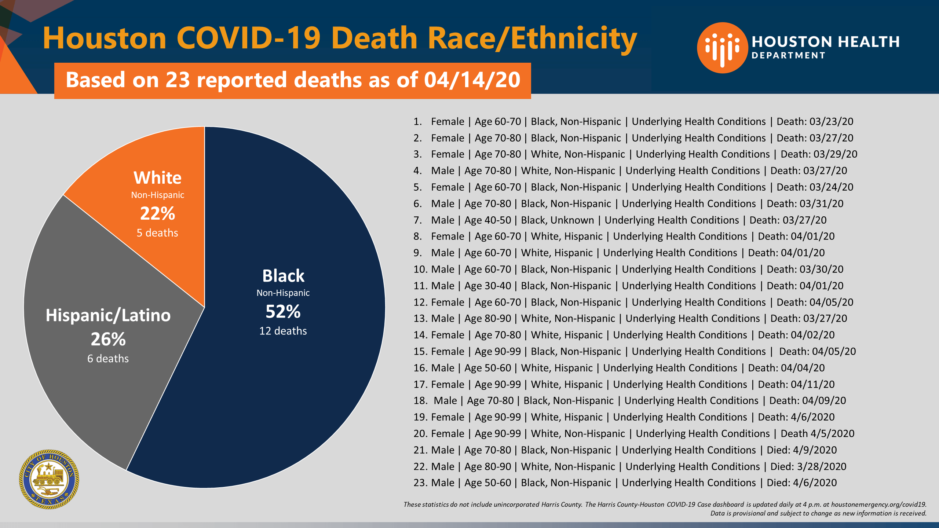

Slide 9

The Empowered Survivor Project
Houston, TX
Due to COVID-19, domestic violence has increased and nearly everyday we see headlines announcing another domestic violence homicide or incident of severe abuse. Interestingly, what is not being discussed is that the majority of the victims are women of color and mainly black women.
This pilot assesses the needs of Black survivors and their families and evaluates the service delivery provided to these survivors during the COVID-19 pandemic.

