Slide 1

Board Member Roles & Responsibilities
West Bank Business Association
February 26, 2020
Sara Wessling
Training Manager
© 2020 Propel Nonprofits
Notes:
This is designed to be a 1.5 - 2 hour workshop.
Handout materials include: Board Boot Camp workbooks, Fiduciary Guides and workshop evaluation forms.

Slide 2
Notes:
Quick highlight of Propel’s programs – refer to page 3 of the Board Boot Camp workbook for an overview of programs.

Slide 3
Session Overview
Fiduciary duties
Board member responsibilities
Discussion
Notes:
3
These are the topics you will be covering in the session.

Slide 4
You’re Legally Bound! Fiduciary Duties
Fiduciary = Involving Confidence or Trust
Board members must exercise duty of care that “an ordinarily prudent person…would exercise…”
    Active participation
    Committees
    Board actions
    Minutes
    Books and records
    Accurate record keeping
    Charitable assets
    Resources
    Investigations
Workbook Page 14
From the Office of Minnesota Attorney General, Fiduciary Duties of Directors of Charitable Organizations
Notes:
Fiduciary Duties
For these 3 slides, we are going to refer to the Fiduciary Duties of Directors of Charitable Organizations from the Minnesota Attorney General’s Office.
Fiduciary means involving confidence or trust. By law, board members are subject to the fiduciary duties of care, loyalty, and obedience, as defined in this booklet. This means that directors must supervise and govern the charity’s efforts in carrying out its mission. It does NOT mean directors actually have to do it – board officers can be appointed, and staff hired to carry out the daily tasks.
When you are a board member for a nonprofit you are legally liable for the organizations. To protect yourself you must adhere to these three fiduciary duties.
Duty of care: act in best interest of organization and community. What would a prudent person do? Participate and be engaged, serve on committees, review minutes, read the bylaws and other records, understand financial reports, properly use assets and help make sure there are adequate resources, investigate warnings. According to BoardSource, board members are expected to attend 75% - 100% of meetings.

Slide 5
You’re Legally Bound! Fiduciary Duties
Board members must exercise duty of loyalty – the director must put the good of the organization first
    Conflicts of interest
    Written policy
    Loans
    Corporate opportunity
    Internal Revenue Code
Workbook Page 14
From the Office of Minnesota Attorney General, Fiduciary Duties of Directors of Charitable Organizations
Notes:
Duty of loyalty: undivided loyalty to the organization. Do not use their position or organization’s assets to generate any gain for them or a family member. Reveal any conflict of interest, never accept a personal loan, do not divert nonprofit business for their own personal gain, no self-dealing.

Slide 6
You’re Legally Bound! Fiduciary Duties
Board members must exercise duty of obedience – the director must follow governing documents, carry out mission, and assure funds are used correctly.
    State and federal statues
    Filing requirements
    Governing documents
    Board training
    Outside help
Workbook Page 14
From the Office of Minnesota Attorney General, Fiduciary Duties of Directors of Charitable Organizations
Notes:
Duty of obedience: Must follow governing documents, carry out the organization’s mission, and assure funds are used lawfully. Must be familiar with state and federal laws relating to nonprofits, filing requirements, and governing documents. On-going board training should happen, and when needed, consult outside counsel.

Slide 7
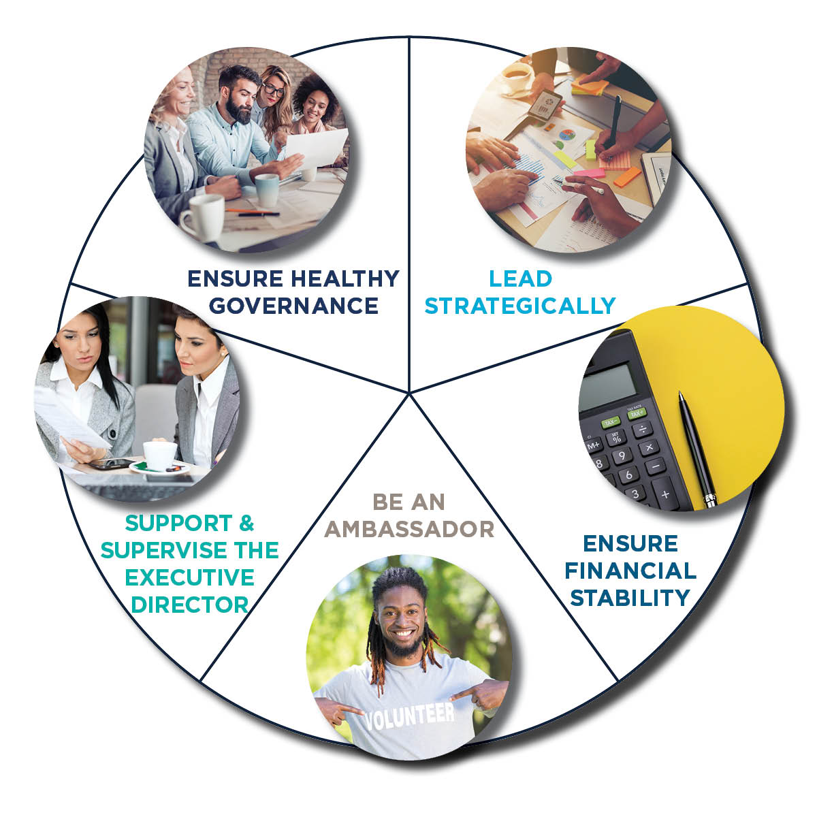
Board Member Responsibilities
Workbook Page 17
Notes:
7
Review on page 17 of the Board Boot Camp workbook.
Pick two of the five areas your board does well.
Pick two of the five areas your board could improve upon.
Poll groups and tally areas that do well and need to improve.

Slide 8
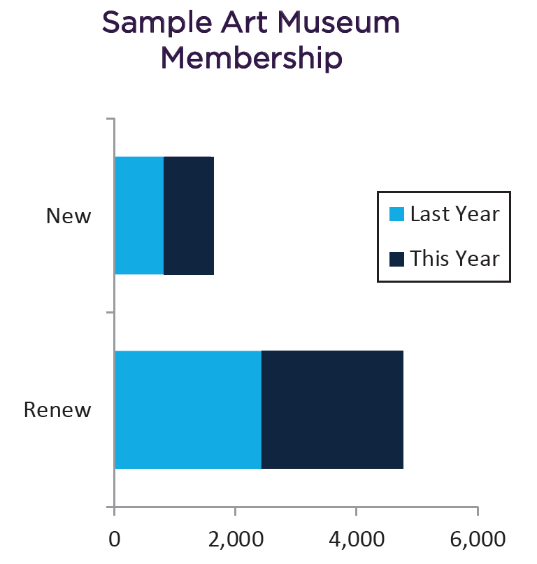
Lead Strategically
Ensure strategic planning/thinking
Monitor and evaluate programs, outcomes, impact, and performance
Create robust meetings
Workbook Page 19-21
Notes:
8
Board Roles & Responsibilities section
Lead Strategically
Leading strategically is the first piece of the pie we will look at.
Ask - What can you do as a board member to ensure you are monitoring and evaluating programs, including outcomes and impact?
Ask - What can you do to ensure meetings are “robust”?
Strategic planning and thinking are core elements of a board’s responsibility. Do you have a clear mission and vision? What are your goals for the next 3 – 5 years? Who is the nonprofit serving? What is the organization good at? What should you stop doing because you are not the best at it? What is the right breadth and depth of programs?
Look for ways to strategically plan for your organization. Tools like a SWOT analysis, identifying your hedgehog, and dashboards can all help. How can you organize the meeting to give the board time to be strategic? How can you come prepared to assist the organization strategically?

Slide 9
Ensure Financial Stability
Program costs
Business Model
Revenue Mix
Infra-structure
Capital Structure
Workbook Page 26-27
8
Notes:
The second pie of the pie is assuring financial stability of the nonprofit.
Ensure as a board member you know how to read the nonprofit’s financial reports. Often a dashboard (page 22) is the best way to make sure the board focuses on the bigger financial concepts and does not get into the individual line items on a budget.
See the sample Balance Sheet and Income Statement in the workbook on pages 23-25 and walk through the 3 questions at the top of pages 24 and 25.
Understand Nonprofit’s Business Model
It is critical for the board to understand a nonprofit’s business model – revenue mix (two major categories are earned income and contributed income), infrastructure (including personnel, technology, marketing, planning), true program costs (direct costs, shared costs, administrative costs, fundraising, core mission support), capital structure (unrestricted net assets typically grown through budget surpluses).
Set Financial Strategy
Go beyond short-term annual budgets to longer financial plans to accomplish strategic goals.
Critical to determine how reliable your revenue sources are and how much you have in reserves for unplanned challenges or new opportunities. This contributes to financial sustainability. Also critical is programmatic sustainability (keep programs relevant) and organizational sustainability (right systems, structures, and people are in place.)

Slide 10
Be An Ambassador & Build Relationships
Have an “elevator speech”
Support strategic alliances and collaboratives
Participate in fundraising efforts
Enhance the organization’s public image
Workbook Page 30-32
Notes:
10
Being an ambassador is the third piece of the pie. You are the public’s representative of the nonprofit and must act professionally in all aspects and settings.
How you behave and what you say are important to your nonprofit’s image. Know about your nonprofit: its programs, who the clients are, the history, funding sources, and be able to describe these deftly.
Discuss the elevator speech.
Ask - Who knows what an elevator speech is?
Ask - Who has an example of an elevator speech? (Give an example, if not)
Optional - Take a moment and write an elevator speech for an organization you know about.
Ask - Who would like to read theirs? (Solicit a couple examples)
Also, being an ambassador includes knowing and supporting who else the nonprofit is working with – other agencies and collaborations. Working closely with others is imperative in today’s environment. Know who does the work you don’t.
Strategic alliances and collaboratives – mergers.
Advocacy – stand for your organization and its mission
Often the board is listed on a website – you are a public face for the nonprofit.

Slide 11
Participate in Fundraising
Assist with the development cycle
Identification
Cultivation
Stewardship
Solicitation
    Provide names
    Bring people to events
    Speak at events
    Host an event
    Find auction items
    Write thank you notes
Workbook Page 32
Notes:
11
Board members must also be involved in the developing of funder relationships by helping to identify, cultivate, solicit, or steward donors.
Very little of a board member’s role in fundraising is begging or cold calling. There are many “comfortable” ways for board members to be involved. See list on page 32. (Give examples of how board members may contribute, e.g., write a check, host a fundraising gathering)
Finally, as a board member, it is important to ensure ethical and legal standards are met regarding solicitations, reporting, recording, and use of funds contributed.

Slide 12
Make a Personal Gift
Total Charitable Giving in Minnesota
Q
A
Does your board require a personal gift?
69% Yes
Workbook Page 32
Notes:
12
Total charitable giving in MN is in line with charitable giving across the country. It is surprising to many that such a large percentage of contributions to nonprofits comes from individuals.
Another way for board members to show their commitment is to make their own financial commitment to the organization. The vast majority of boards ask that each board member make a gift. This should be covered in the board member job description. Funders will often ask for the percent of board members making a contribution – not the size of the gifts.
BoardSource: 69% of public charities require board members to make a personal gift (some are a give-or-get contribution). Boards average 79% participation in giving, but on average only 52% have 100% participation.

Slide 13
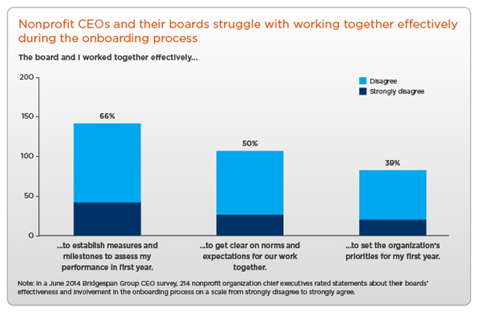
Supervise and Support Executive Director
Select, set goals, evaluate and support the ED
Attend to succession planning
26% of CEOs will be leaving within the next three years
27% of organizations have a written succession plan
58% of charities have done an ED review in the past year
Workbook Page 33-34
Notes:
13
Board Roles & Responsibilities section
Supervise & Support the Executive Director
Working with the ED is also a critical responsibility of the board. It is the fourth pie piece. The relationship the board has with the ED can make a big difference in the nonprofit’s success.
Note the statistics in the box. These boxes will show up on slides throughout the remainder of the training. This data comes from BoardSource’s 2017 Leading with Intent survey.
If you look at the ED review stat…this means 40% have not gotten formal feedback on their performance in the past year. The Board Chair might be the designated individual to give informal performance feedback to the ED. As a board member you should share information and observations to the Board Chair so they can be passed along. Additionally, each board should develop a formal review process that is regular and well-articulated.
Clear expectations and milestones are critical. Provide the ED the resources needed for success.
ED is often a very lonely, isolated position.
Succession planning is a must – not only for the ED but for other staff and board positions.

Slide 14

Ensure Healthy Governance
Actively participate
  Show up
  Do your homework
  Be respectful
Only 20% of CEOs feel their board members are
prepared to a great extent for meetings
Workbook Page 35-37
Notes:
14
Ensuring healthy governance is the fifth and final pie piece.
This slide reiterates the board member’s fiduciary Duty of Care to come to board meetings prepared.
On average it takes an Executive Director up to a week of going back and forth with staff and the Board Chair to prepare meeting materials for a board meeting. The statistic noted likely indicates frustration on the side of an Executive Director if board members are coming to meetings unprepared.

Slide 15
Develop Cultural Competency
Be engaged with your community
Cultivate an open and adaptive board
Actively learn about those who differ from you
Know yourself and face your own cultural and racial biases
Other biases can include gender, age, ability, socioeconomic, etc.
Workbook Page 35
Notes:
15
This point speaks to the need for each board member to continually work at increasing their cultural competency as they face their own cultural and racial biases (and other biases like age, gender, ability, socioeconomic, etc.)
Know your community, know your client base, know yourself, and learn about those who differ from you, ask questions, seek divergence, and keep learning! This is about you, but also about the need to have a diverse board. A good goal is to have the board reflect your community and client base.
Before you bring in new board members, the board needs to be ready to welcome, support, and empower the new board members.
Note that diversity, inclusion, and equity are important at the board and staff level.

Slide 16
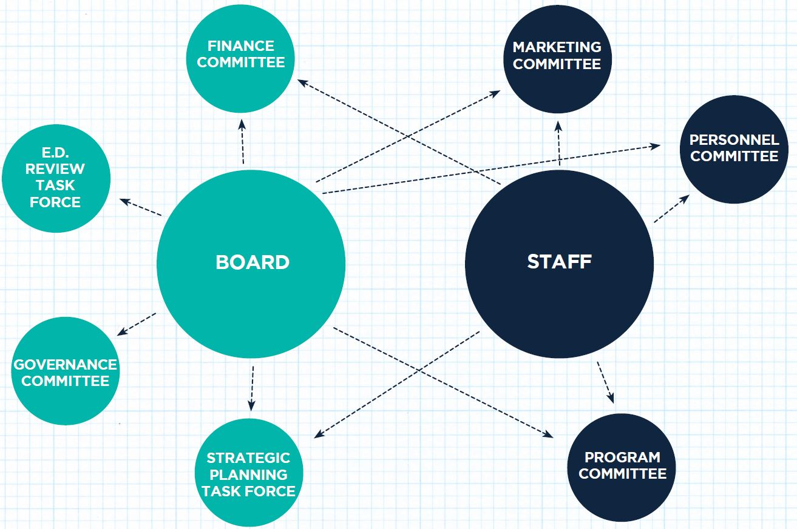
Encourage Effective Structure
Have board committees doing board work
Boards have an average of 4.5 committees
Workbook Page 36
Notes:
16
Most boards have committees. It is important to distinguish whether it is a board committee or a committee of the staff. Board committees are formed to help the board do its work and should not handle issues assigned to the Executive Director or other staff. Typical standing board committees might be finance or board development. On staff committees, a board member serves in an advisory role for input – not final decisions or action.
Best practice is to have very few standing committees and more ad hoc committees or task forces formed for specific initiatives, like raising capital funds or determining executive compensation. Whatever committees you have, make sure to clearly define their roles. If you are on a committee, take it seriously and be a responsible member.
Committees can serve as a pipeline for board recruitment.

Slide 17
Recruit & Orient Board Members
Be purposeful about board composition
Have a process
Seek or be a buddy to a new member
21% of CEOs rank recruitment practices among top three areas needing improvement.
Workbook Page 37
Notes:
17
While sometimes boards have nominations committees, it’s the full board’s role to determine what kind of board members are needed, identify, and help recruit good board members.
When a new board member joins the board, help the person get oriented. When you are new, ask for a “buddy” and ask for and study historical data to get up to speed on issues and background.

Slide 18
Continuously Develop Board
Engage in active learning
Create a sense of team
Regularly conduct a board self-evaluation
45% of boards have conducted a self-assessment in the last 3 years
Workbook Page 37
Notes:
18
Finally, an effective board is one that is informed and knowledgeable about itself, the organization, and the community served. A board should regularly do a self-assessment and develop trainings based on the board’s current needs.
Use some of the resources we have given you here as ways to educate and inform other board members of what can be done to continually increase effectiveness. (Give examples of what else could be done, e.g., board self-assessment, field trips, open houses, speakers)

Slide 19

Discussion
In small groups:
What does your organization have to celebrate?
How can your organization improve?
What are your next steps?
Notes:
19
Now that we’ve covered the five board roles and responsibilities, let’s take a few minutes to debrief.
Discuss as a group:
What does your organization have to celebrate?
How can your organization improve?
What are your next steps?

Slide 20
Thank you!

