Slide 1
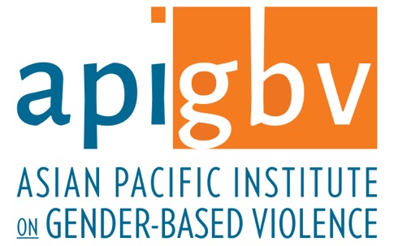
Strengthening Community Responses to Gender-Based Violence Asian and Pacific Islander Communities
Asian Pacific Institute on Gender-Based Violence
Culturally Specific Resource Center
Grace Huang
Policy Director
(206)420-7369
ghuang@api-gbv.org

Slide 2
What We Do
Asian Pacific Institute on Gender-Based Violence serves as a resource to advocates, systems, policy makers and CBOs serving 50+ Asian, Middle Eastern, Pacific Islander communities w/75+ languages, by:
Analyzing culturally-specific dynamics and trends
Providing training/technical assistance that builds system capacity to be gateways, not barriers, to services
Researching and compiling fact sheets, evidence-informed practices, community engagement models
Collaborating to influence public policy
Supporting Asian and Pacific Islander programs and advocacy networks

Slide 3
Resources
Culturally Specific Service Delivery
Community Engagement
Domestic Violence
Economic Security
Engaging Men Transforming Gender Roles
Facts & Stats
Forced Marriage
Homicide and Asian Families
Immigrant Survivors
Innovative Strategies
Islamic Marriage Contracts
Language Access, Interpretation
Lifetime Spiral of Gender Violence
Sexual Violence
Trafficking
Translated Materials

Slide 4
Facts & Data on AANHPI Communities in the US
Implications for Services & Prevention

Slide 5
Who are Asian Americans?*
According to US Census:
People having origins in any of the original peoples of the Far East, Southeast Asia, or the Indian subcontinent
2017 Census Bureau population estimate of 18.2 million Asian Americans living in the US, or approximately 5.6 percentage of the US population
From 2010 to 2017, number of Asian Americans grew by more than 25%
2/3 of Asian Americans born abroad (the largest share of any major racial or demographic group, i.e. even Hispanics are second at 1/3)
US States w/largest Asian American Populations
CA, NY, TX, NJ, IL, WA, FL, VA, HI, MA
*Data from the 2017 Census

Slide 6
Who are Native Hawaiians and Pacific Islanders?*
This racial group refers to people having origins in any of the original peoples of Hawaii, Guam, Samoa or other Pacific Islands
According to the 2017 U.S. Census Bureau estimate, there are roughly 1.5 million Native Hawaiians/Pacific Islanders alone or in combination with one of more races who reside within the United States. This group represents about 0.4 percent of the U.S. population. 31.2 percent of this group is under the age of 18, as compared to 18.8 percent of the non-Hispanic white population
About 367,000 Native Hawaiians or Pacific Islanders reside in Hawaii
2015 populations for the following U.S. Territories are: American Samoa 57,000; Guam 161,700; Northern Mariana Islands 52,300. United Nations population estimates for other territories in 2015 are: Federated States of Micronesia 109,000; Marshall Islands 57,000; Republic of Palau 18,000.
In 2017, ten states with the largest Native Hawaiian/Pacific Islander populations were: Hawaii, California, Washington, Texas, Utah, Nevada, Arizona, Florida, Oregon, and New York
*Data from the 2017 Census

Slide 7
Language Fluency
The percentage of Asian American persons 5 years or older who "do not speak English very well" varies among Asian American groups:
48.9 percent of Vietnamese are not fluent in English
44.8 percent of Chinese,
20.9 percent of Filipinos and
18.7 percent of Asian Indians
Overall, 32.6 percent of Asian Americans are not fluent in English.
In 2017, 74.4 percent of Asian Americans spoke a language other than English at home.
*Data from the 2017 Census

Slide 8
Educational Attainment
According to 2017 U.S. Census data, roughly 86.9 percent of all Asians in the United States 25 and older had at least a high school diploma, as compared to 92.9 percent of non-Hispanic whites.
However, 53.8 percent of Asian Americans in comparison to 35.8 percent of the total non-Hispanic white population had earned at least a bachelor's degree. Among Asian subgroups, Taiwanese had the highest percentage of bachelor's degree attainment at 77.7 percent. 23.6 percent of Asians held a graduate degree, as compared to 13.8 percent of non-Hispanic whites
In 2017, 89.4 percent of Native Hawaiians/Pacific Islanders, alone or in combination, had high school diplomas or higher, as compared to 92.9 percent for whites. 23.3 percent of Native Hawaiians/Pacific Islanders had a bachelor's degree or higher in comparison to 35.8 percent of whites. 6.9 percent of Native Hawaiians/Pacific Islanders have obtained graduate degrees in comparison to 13.8 percent of whites. 27.6 percent of Native Hawaiians/Pacific Islanders speak a language other than English at home.
*Data from the 2017 Census

Slide 9
Economics
Economic status varies widely among Asian, Native Hawaiian and Pacific Islander populations in the United States
The overall median household income of Asian Americans was $83,456, as compared to $65,845 for non-Hispanic whites.
The average Native Hawaiian/Pacific Islander median household income was $60,734 in comparison.
11.1 percent of Asian Americans and 15.4 percent of Native Hawaiians/Pacific Islanders, in comparison to 9.6 percent of non-Hispanic whites, were living at the poverty level.
The poverty rate for Filipinos at 6.0 percent, as compared to 16.2 percent for the Hmong, in 2017.
Regarding employment, 52.1 percent of Asian Americans were employed in management, professional and related occupations, compared with 42.9 percent of the non-Hispanic white population. In addition, the proportions employed in managerial sectors varied from 27.3 percent for Cambodians to 73.3 percent for Taiwanese.
*from 2017 Census Data

Slide 10
Facts and Stats on Gender Violence
18% of Asian or Pacific Islander women reported experiencing rape, physical violence, and/or stalking by an intimate partner in their lifetime in a national survey, as compared to 48% of American Indians or Alaska Native women, 45% of Black women, 34% of Hispanic women, and 37% of White women.
Of API women, 23% experienced some form of contact sexual violence, 10% experienced completed or attempted rape, and 21% had non-contact unwanted sexual experiences during their lifetime.
8% of API women experienced stalking in their lifetime
CDC: 2010-2012 National Intimate Partner and Sexual Violence Survey (2017)

Slide 11
Facts and Stats on Gender Violence

Slide 12
Training and Technical Assistance Resources

Slide 13
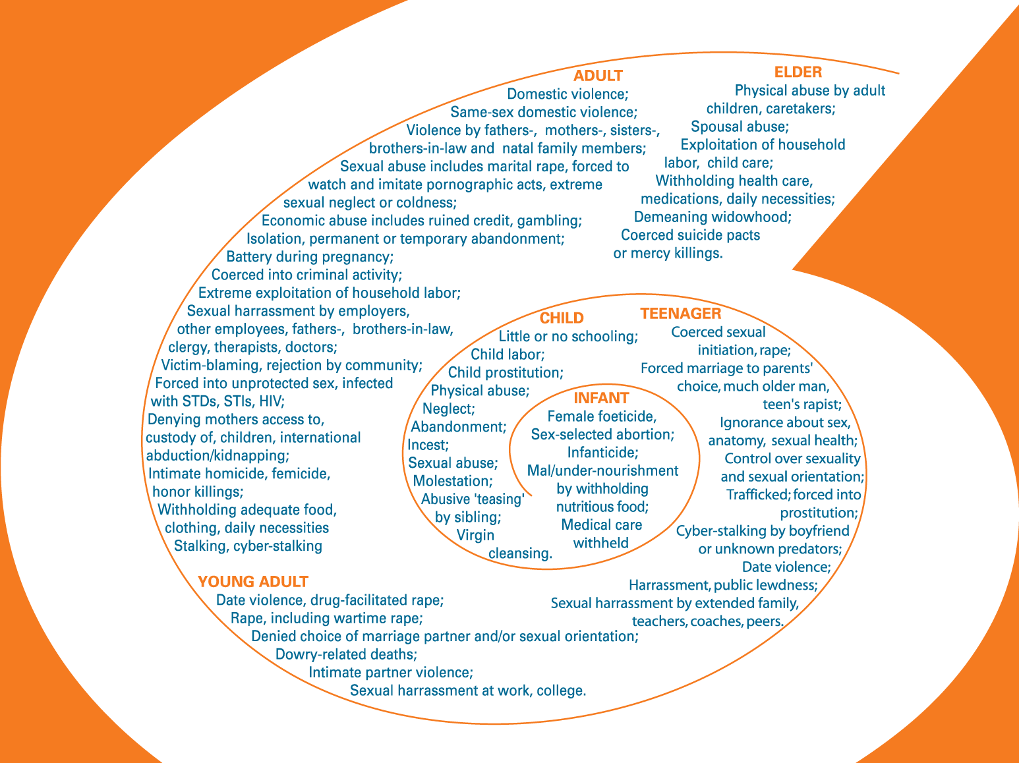
Lifetime Spiral of Gender Violence
© Asian Pacific Institute on Gender-Based Violence

Slide 15
Violence against women and girls is historical in nature: not accidental, not bad luck, not bad judgment, not a single event
There are many types of abuses girls and women are vulnerable to, or may experience at different lifecourse stages
Various perpetrators are located across lifecourse: E.g., incest by father in childhood; cyber-stalking by boyfriend in school; sexual harassment by coach in college, clergy in church; forced to disavow sexual orientation by homophobic parents; DV by intimate; elder abuse by care-giver and/or adult children.

Slide 16
Training and Technical Assistance
IMPACT: ASIAN/PACIFIC ISLANDER LIFETIME SPIRAL
Culturally-specific advocacy for API DV/FV survivors expands to include abusive international marriage, elder abuse, forced marriage, intimate homicide, trafficking, etc.
Prevention tool used by advocates to raise awareness, address victim-blaming and engage API communities
Systems integrate cultural trends/dynamics, language access, trauma-informed care to mitigate barriers
REACH: NATIONAL & INTERNATIONAL
State coalitions, youth programs, legal services, courts, interpreters, substance abuse programs, theatre groups, Christian/Muslim faith groups, researchers, housing, federal agencies, CBOs serving APIs, Native, Latinx, other survivors
Australia, China, Japan, Laos, Thailand

Slide 17
Training & Technical Assistance
Factors increasing Barriers to Safety for AAPI and immigrant Survivors that abusers can leverage
Isolation from family and community
Cultural Norms
Language Barriers
Lack of knowledge and misinformation about the U.S. systems and resources
Fears of the Police and Judicial System, of deportation, of social services and child welfare agencies, etc… (fears from experiences in country of origin and U.S. environment)
Discrimination
Economic and Employment challenges

Slide 18
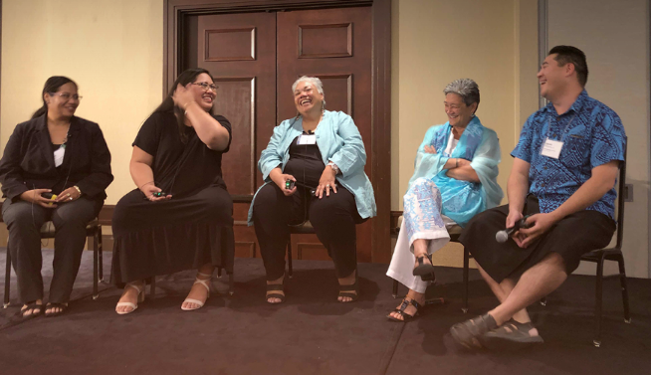
Networking, Peer-Based learning and Training
TRAINING & TECHNICAL ASSISTANCE
National Summit 2018 Asian Pacific Islander Agents of Change: Disrupting Gender Violence | Defining Gender Democracy:
200 advocates, policy makers, researchers
100 agencies represented
77 were culturally-specific CBOs serving Asian, Arab, Native Hawaiian, Pacific Islander communities
It’s great to learn seemingly common issues in a more eye-opening manner and learn and brainstorm new and better practices on working with our immigrant and refugee survivors of domestic violence.
We help survivors who walk from “I feel worthless” to “I have power”
We young women said: We will be the leaders, we will create a new moral compass for our communities.

Slide 19
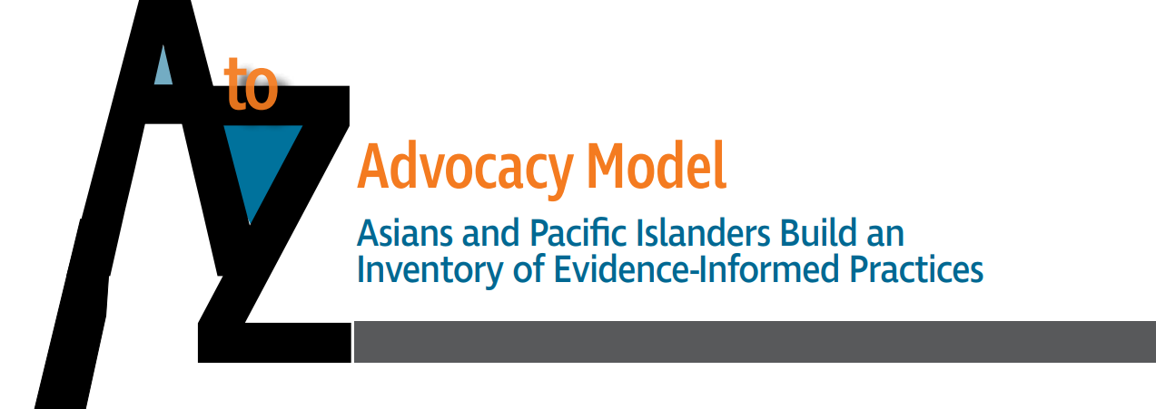
Supporting Culturally Specific Advocacy

Slide 20
Culturally relevant and competent safety planning
See, A-Z Inventory of Evidence-Informed Practices : https://www.api-gbv.org/culturally-specific-advocacy/a-to-z-advocacy-model/
Principles:
Analysis of how power, equality, empowerment of intersectionality of oppressions, including, racism, gender bias & patriarchy, xenophobia
Advocacy addresses building culturally specific interventions, confronting root causes (ie systems & life risks)
Designing services that address ethnic, linguistic diversity, including expanding language services to match changing needs of ethnic communities & providing language access
Survivor centered advocacy based on a culturally specific analysis and definitions of domestic and family violence
Understanding impact of abuse over life course, and negative & positive help-seeking experiences
Engaging in systems advocacy through collaboration, research, policy advocacy

Slide 21
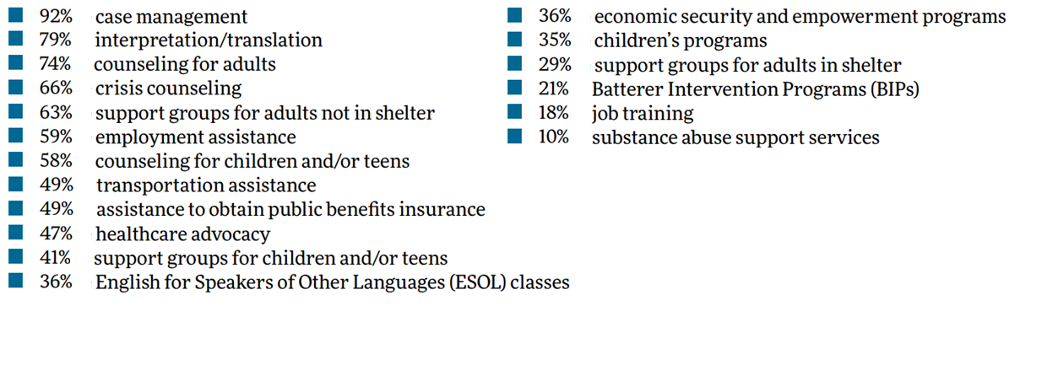
Support Services
Services provided by these 137 agencies:

Slide 22
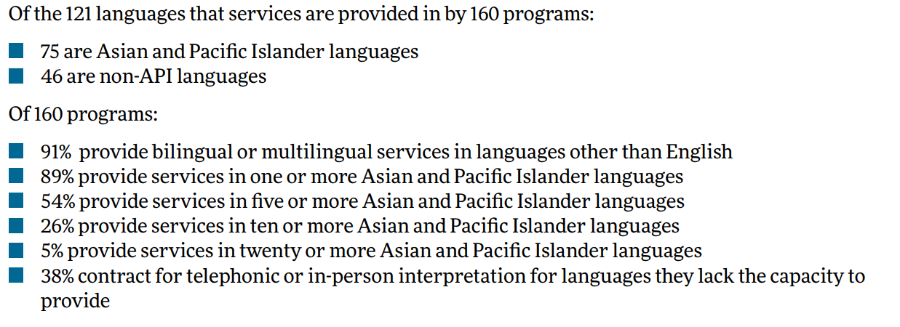
Language Services

Slide 23
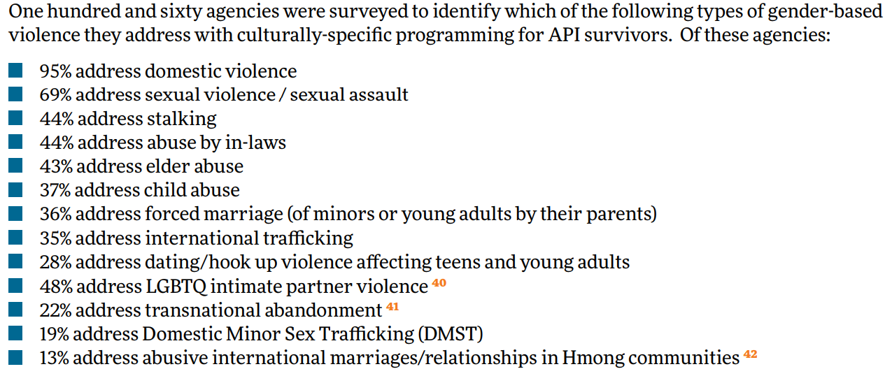
Abuses Addressed

Slide 24
Interpretation Technical Assistance Resource Center
Training and technical assistance for victim service providers and systems partners on providing survivors with limited English proficiency (LEP) meaningful access to programs and services through:
developing and implementing effective language access plans,
training on working with interpreters,
working with law enforcement and courts to improve language access,
Title VI compliance,
building interpreter pools,
interpretation skills training, and
systems advocacy.

Slide 25
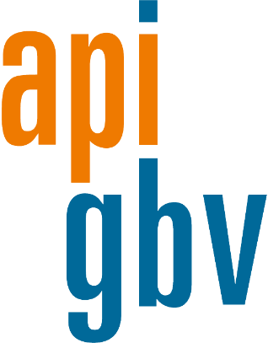
Asian Pacific Institute
on Gender-Based Violence
500 12th Street, #330
Oakland, CA 94607
415.568.3315
info@api-gbv.org
www.api-gbv.org

