Slide 1
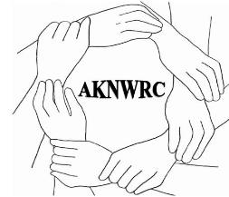
Building our Capacity to Serve Alaska Native Survivors
May 27, 2020
Webinar
Tami Truett Jerue
Executive Director

Slide 2
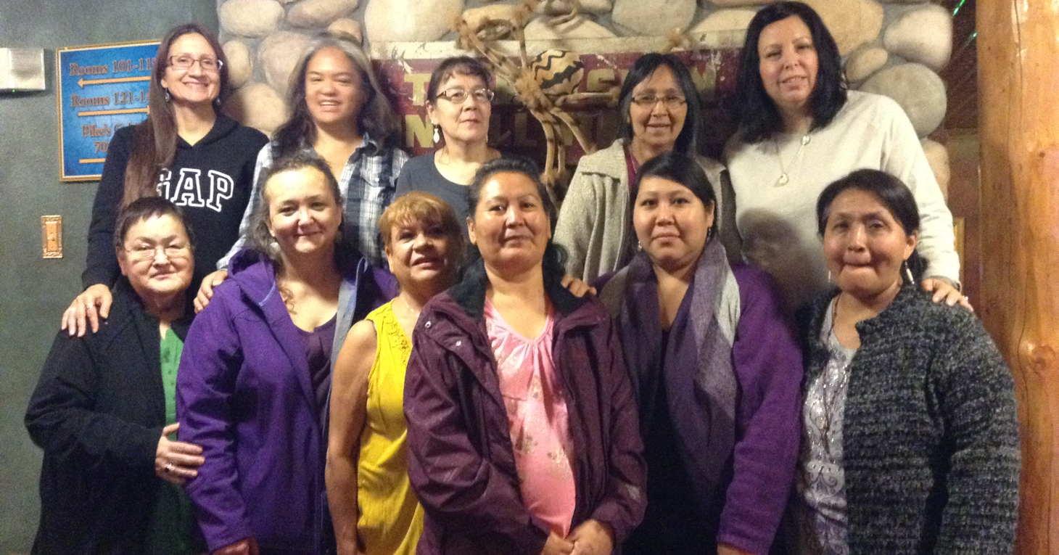
AKNWRC Founders/Partners
Alaska Native Women’s Resource Center
National Indigenous Women’s Resource Center
Indian Law Resource Center
Steering Committee are village-based advocates from across the state working to address domestic violence & violence against women in Alaska Native villages

Slide 3
Why is the Alaska Native Women’s Resource Center Necessary?
Historic federal recognition of disparities of domestic violence in Alaska Native tribes:
Critical need to provide Alaska Natives with additional support because of unique issues
  Disproportionate rates of DV
  Isolated villages without basic resources and law enforcement
  229 tribes, and only 2 Native shelters within state

Slide 4
ALASKA NATIVE WOMAN’S RESOURCE CENTER
Program goals, to provide:
Technical Assistance & Training
Public Awareness/Resource Development
Policy Development & Systems Advocacy/Engagement
Notes:
In the next year through Sept. 30, 2018, some of our activities include, but are not limited to:
4 on site village engagement sessions
3 Regional trainings
Research roundtable
Annual Unity Mtg. & AFN
NCAI 3x/year, incl. Hill Briefing
Women Are Sacred June 2018 (pg. 44)
Resource material development, incl. www.aknwrc.org

Slide 5
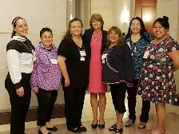
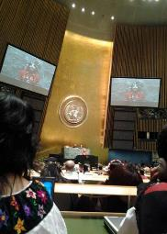

Increasing the Response of the Villages to Domestic Violence
Village
Written & Unwritten
Federal United States
State
International

Slide 6
Organizing & Facilitating a Process of Discussion & Engagement
Facilitating a discussion within village/s to:
Provide victims with pathways to safety
Increase the accountability of abusers
Increase the village response to domestic violence
Determine changes needed within the village to increase village-wide responses to domestic violence within the village
Provide culturally specific TA/Training highlighting barriers and solutions specific to rural Alaska Native Villages.

Slide 7
Technical Assistance & Training
Customized curriculum to strengthen the local response to DV
  Each village has their own laws, systems, histories and beliefs
  We will help map out systems and see where gaps exist and provide recommendations for services, training and funding.
Training material will recognize unique legal needs
  Use local voices, languages and teachings
  We believe you are in the best position to identify the issues and response necessary to address these issues—we help you get there.
Identify and recommend partnerships and resources to strengthen community
  Database of resources, toolkits and other materials

Slide 8
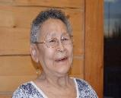
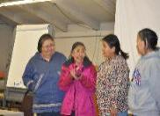
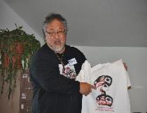
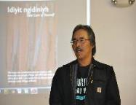
Two Part Curriculum Trainings in 2015 & 2017
-2 in Village of Kotzebue/Nana Region- 2 in Organized Village of Kake – 1 in Village of Emmonak – 1 in Village of Anvik
Village of Emmonak
Organized Village of Kake
Village of Anvik
Village Kotzebue / Nana Region

Slide 9
Indigenous Curriculum
Foundations & Core Principles
Voices of our people
Languages of our people
Teachings of our people
Notes:
Discuss why this curriculum is indigenous. Examples are on the slides to follow.

Slide 10
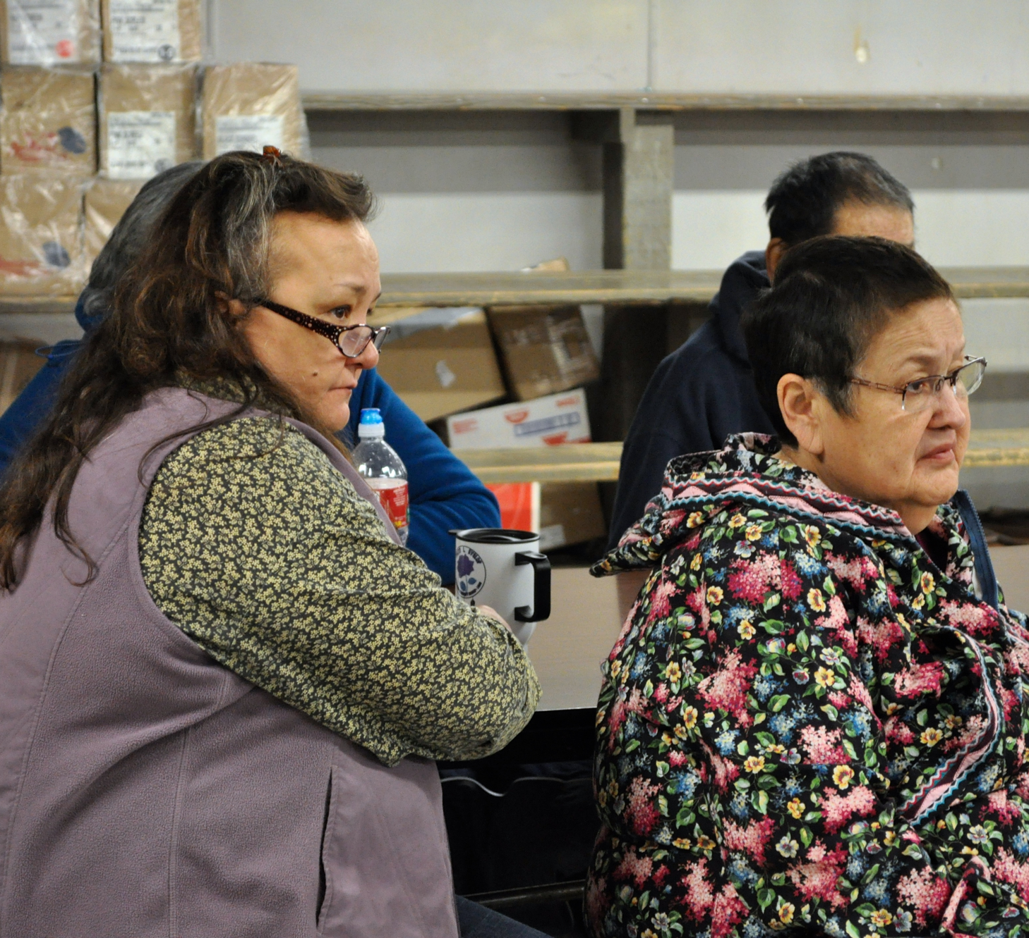
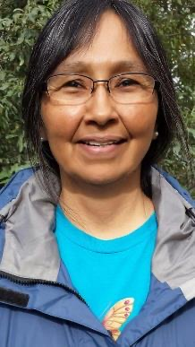
In Our Own Voices Videos
Beginnings of Violence Against
Native Women
Shirley Moses, Tami Truett Jerue, Lynn Hootch
We Want Our Women to be Safe
Joann Horn
Notes:
Time permitting - share videos
And other Alaska Natives on the agenda

Slide 11

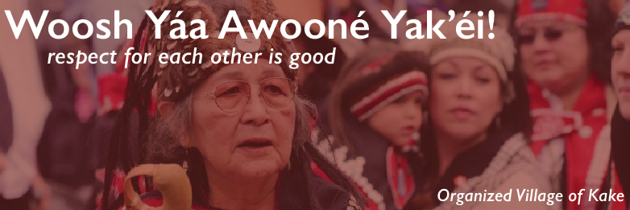
In Our Own Languages
Notes:
Deg Xinag
Deg it’ an
Deg Xit’ an

Slide 12
Public Awareness & Resource Development
  Contacts for individuals/tribes/organizations interested in information and materials, list serves
  Online and social media connections
  Informational mailers
  Media relations
  Program Website—”Virtual” Distribution Center:
    News announcements
    Articles
    Tools—Posters, fact sheets, bumper stickers, etc.
    Updates
    Resource materials
    Mail jump drives to communities without adequate internet
  Webinars—live and recorded/archived

Slide 13
Resource Development Example
Development of an Alaska Native Domestic Violence Video Curriculum
Create an Alaska Native Video Curriculum on domestic violence that is indigenous to Alaska Natives, not the lower forty-eight or other peoples.
Community Engagement - Based on our collective knowledge of our villages, experience of domestic violence, and our experiences as Alaska Native women.
Indigenous process of increasing the self-reliance of villages, given the reality that most villages lack resources to address the current epidemic of domestic violence and violence against Native women.

Slide 14
Public Awareness & Resource Development
Collection and development of resource materials specific to Alaska Natives
toolkits, factsheets, PowerPoints, AKNWRC video curriculum referenced earlier
E-Publications– newsletter about interests, interventions, preventions
Public Awareness Events and Materials to Share
DV Awareness Month (October)
Stalking & Trafficking (January)
Dating Violence (February)
Sexual Assault and Child Abuse Prevention (April)
Other days of interest: Women’s History, Mothers and Fathers Day.
RESOURCES!!!!

Slide 15
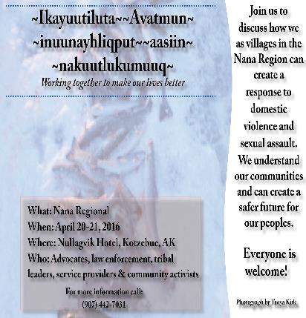

Indigenous Based Materials
Flyer developed for Nana Region hosted in Village of Kotzebue
Flyer developed for Village of Anvik

Slide 16

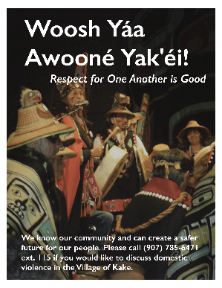
Indigenous Based Materials
Poster developed for Native Village of Emmonak
Poster developed for Organized Village of Kake

Slide 17
Policy Development & Systems Advocacy/Engagement
Monitor and inform communities of local, State and Federal law and policy changes/improvements that can benefit AN communities
Provide education about law and policies to ensure systemic responses are comprehensive and trauma informed
  Goal to build local capacity, control and infrastructure within your communities
Annual Policy planning to coordinate system improvements
Build beneficial partnerships with local, state and national organizations
Specific training and technical assistance on govt-to-govt consultations
Family Violence Prevention Services Act (FVPSA) service engagement
Annual Unity meeting Pre-AFN

Slide 18
How to Stay Connected and/or Request Technical Assistance
  Sign up to be added to AKNWRC’s list serve
  Request village support
  Attend regional meetings
  Attend Pre-AFN Unity Meetings
  Attend NCAI Mid-year and Annual Alaska Leaders Caucus

Slide 19


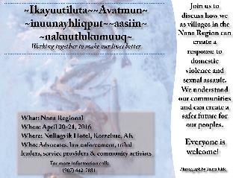
Questions comments

Slide 20
Feel Free To Contact Us!
Alaska Native Women’s Resource Center
P.O. Box 80382
Fairbanks, Alaska 99708
Ph 907/328-3990
Fax 1-866-287-8330
tami.jerue@aknwrc.org
www.aknwrc.org

Slide 21

Quyana Tsenaa-’ii Gunalchéesh Dogindihn Háw’aa DOIKshin Ana-basee’ Masi-cho
This publication was made possible by Grant Number #90-EV-0454-01-00 from the Administration on Children, Youth and Families, Family and Youth Services Bureau, U.S. Department of Health and Human Services. Its contents are solely the responsibility of the authors and do not necessarily represent the official views of the U.S. Department of Health and Human Services.
Notes:
….

