Slide 1

Databases:
The Intersection of Law &
Best Practice
FVPSA State Administrators Webinar Series
Presenters:
Alicia Aiken, JD– Director, Confidentiality Institute
Corbin Streett, MSW – Technology Safety Specialist

Slide 2
Confidentiality Institute
Empower people to protect privacy for violence survivors.
Support non-profits and government agencies to implement services consistent confidentiality best practices.
Assist everyone to understand the web of confidentiality, privilege and mandated disclosure laws.

Slide 3

Alicia L. Aiken, JD
Since 2011, Director of Confidentiality Institute
Principal at Danu Center for Strategic Advocacy
Attorney with 15 years experience representing survivors of violence & people living in poverty
alicia@confidentialityinstitute.org

Slide 4

Safety Net Project
Addresses intersection between technology and abuse.
Provides technical assistance and training to advocates, law enforcement, legal services, social services providers, and survivors.
Advocates with policymakers
and technology companies.

Slide 5

Objective
Take a deep dive into the practical realities of implementing a database that is consistent with the law on confidentiality for FVPSA grantees.
Answer your questions about how best to support programs to implement best practices

Slide 6
Laying the Foundation
We are talking about how to support local programs you are monitoring in selecting and maintaining a database
The legal requirements and best practices related to a local program’s selection and use of a database are quite different than those related to databases used by state administrators

Slide 7
Different Systems, Different Purposes
Local Programs:
Collect personally identifying information from survivors in order to help them on their path to safety
State & Territorial Administrators:
Collect aggregate information from programs about the number of victims served

Slide 8
Federal Grant Requirements
FVPSA, VAWA, VOCA Grantees
Shall NOT disclose, reveal or release any:
  Personally identifying information (PII)
  Collected in connection with program services that were requested, utilized, or denied

Slide 9

Keep the Data Separate
Identifiable Agency Data should be siloed.
Each program should have
their own database.
No program should be
able to access information
collected by other
programs.
State/territorial administrators should not have access to the local program’s database.

Slide 10

A Database is Like a Cookie Jar

Slide 11

Who is allowed in the Cookie Jar?
FVPSA prohibits disclosure of PII to those outside the victim services unit
Except when survivor requests it
Or when court/ statute requires it

Slide 12
Inside/Outside the Circle
Outside the Circle
Law Enforcement
Child Welfare
Other V.S.P’s
Non Victim Service Programs
Funders
Auditors
Allies
Vendors
Inside the Circle
Survivor chooses
to share information
with staff of
victim services program

Slide 13
Helping Local Programs Understand & Choose Databases

Slide 14
Assumptions that Vendors Make
Losing access to data is agency’s biggest concern
If it’s affordable to save data forever, it should be saved forever
Ease of sharing access to data is agency’s primary goal
Vendors can be trusted to see everything
Potential misuse of data is a small & acceptable business risk

Slide 15
Grantee Values & Needs
Misuse of survivor data can result in permanent, serious harm
Best Practice: keep only the data needed to help the survivor
Best Practice: share internally only as needed to help the survivor
Data is and should be routinely destroyed on a set schedule

Slide 16

Routine data destruction is a healthy part of information management!

Slide 17
Heightened Risks for Survivors
Most abusers/stalkers and their allies would pass a background check
A data breach can’t be fixed by mere credit monitoring
Contacting a survivor to notify of a breach might increase danger
Even a small risk of misuse of data is not an acceptable business risk

Slide 18
Exposed on the Web!
211 LA County stored data on Amazon web:
Mistakenly available for public download
Cybersecurity firm found records of:
  33,000 Social Security numbers
  Full names & addresses
  200,000 call logs with detailed notes
    Describing elder abuse & mental health crises
May 2018 LA Times: https://www.latimes.com/local/lanow/la-me-ln-211-data-20180515-story.html

Slide 19
What Do Grantees Need?
Detailed information management plan, including destruction policy
Funds to hire qualified internal systems administrator/tech person
Legal counsel when negotiating database contracts
Awareness of the collateral costs of using this information management system

Slide 20
Ease of Access & Sharing…
Creates training, supervision, and monitoring costs
Web-access means
  Controlling which devices have access
  Encrypting devices that will be lost/stolen
  Training staff not to use access carelessly
  Controlling who has access to how much
  Shutting off access promptly

Slide 21
Data Breach Notification…
VAWA now requires grantees to have a data breach notification policy
All states have data breach notification laws
Existing law focusses on notifying people so can protect against identity theft
Contacting survivors to notify them can be dangerous to them
WEBINAR & TA ARE COMING!

Slide 22
But…Everybody’s Doing the Database Dance

Slide 23

“We’re HIPAA-Compliant”

Slide 24
Data Sharing: HIPAA vs. FVPSA
HIPAA
FVPSA / VAWA
Healthcare providers can choose to share Personal Health Information (PHI) as part of doing business
Providers and their business associates are monitored by HHS Office of Civil Rights
Business Associates can be fined if don’t protect PHI
Grantees can’t decide to share PII as part of doing business; only survivors can
No OCR involvement in monitoring grantees or vendors
No power to oversee, monitor or fine vendors

Slide 25
Databases & Their Sales Teams

Slide 26
What Can Vendors Do for Privacy?
IDEAL STRATEGY
Make it so vendor can’t READ the data
“Zero Knowledge” or “No Knowledge” Encryption
  Data is locked up, you have a key, vendor doesn’t
Vendor can’t expose information if they can’t read it
Thieves can’t read it either

Slide 27
What Can Vendors Do for Privacy?
BACK-UP PLAN
1 – 2 named staff at vendor have access
Named staff receives DV/SV privacy training
DV/SV agency can veto named staff
Vendor pays liquidated damages if breach
Vendor will notify & forward subpoenas/orders
BUT - breaches can still happen!
  Thieves can still read what they steal

Slide 28
Conversations with Programs:
Vendor Access & Program Control
Can the vendor access the program’s information?
Can programs get their data back at any time?
Can the vendor move, release, or share the program’s data without its permission?
What will the vendor do with a request from government, law enforcement, lawyers?
Will they provide notice to the program if they release the program’s information to someone else?
What is in their privacy policy?

Slide 29
Conversations with Programs:
Data Ownership vs. Possession
Where is the data, including back-ups?
Will they purge information according to the program’s data retention schedule?
What happens to the data when the service agreement ends?
What happens to the data if the company changes ownership or goes out of business?

Slide 30
Conversations with Programs:
Security & Encryption
Is data encrypted in transit? At rest?
Is data zero knowledge / no knowledge?
Who has the key?
Does the vendor provide notice of requests for information, hacks, or breaches?
Does the company perform security audits?

Slide 31
Poll Question
Given the information presented in this webinar, how confident do you feel now about talking to programs about databases?
Very Confident
Confident
Somewhat Confident
Not Very Confident
Datawhat? 🤔

Slide 32
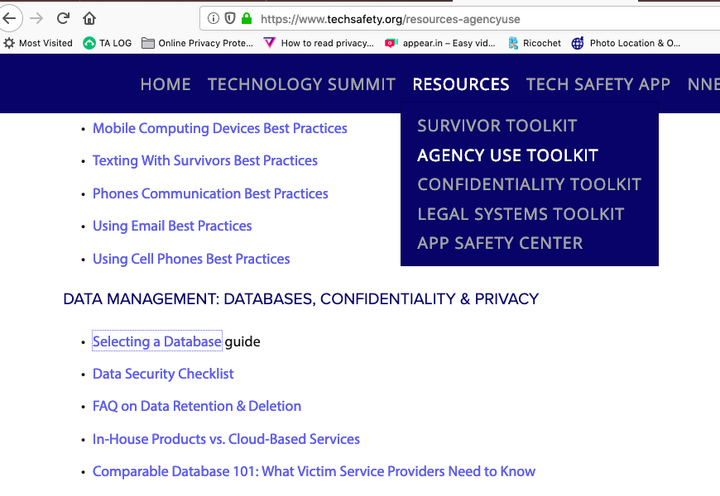
Resources? We’ve Got You Covered!
Check out our database TA materials at techsafety.org

Slide 33
Digital Services Webinar Series
Assessing Readiness, May 7
Choosing a Platform & Vendor, May 23
Best Practices, May 30
All webinars will be held from
3:00-4:30 PM ET

Slide 34

QUESTIONS?

Slide 35

Contact Information
Alicia Aiken
alicia@confidentialityinstitute.org
Corbin Streett
cstreett@nnedv.org
Safety Net Project
safetynet@nnedv.org
Database Resources
https://www.techsafety.org/resources-agencyuse
This webinar was made possible by Cooperative Agreement, Award Number 90EV0429-02-00, from the Administration on Children, Youth, and Families, Family and Youth Services Bureau, U.S. Department of Health and Human Services. Its contents are solely the responsibility of the author(s) and do not necessarily represent the official views of the U.S. Department of Health and Human Services.

